Slide 1
UNIT 2: RETEAIL TERMINOLOGY & PRACTICES
RETAIL SKILLS 4N1183
RTS 2: Explain key terminology and practices utilised in retail selling to include related sales, up selling, after sales service, customer service and unique selling points.

Slide 2
RETAIL TERMINIOLOGY & PRACTICES: TOPICS
TERMINOLOGY
PRACTICES
CUSTOMER SERVICE
RETAIL SELLING
UNIQUE SELLING POINT

Slide 3
RETAIL TERMINOLOGY
The following is a list of words often used in retail. Listen as the tutor read’s through them and Circle any words whose meaning you know.
Customer Store Assistant Returns Faulty Goods Sale or Return Consumable Item Receipt Shoplifting Footfall Average Transaction Value Stock Loss | Repeat Sales Merchandising End of the Line Batch Products Sale of Goods Act Statutory Rights Guarantee Warranty Store Standards Product Groups Store Hygiene

Slide 4
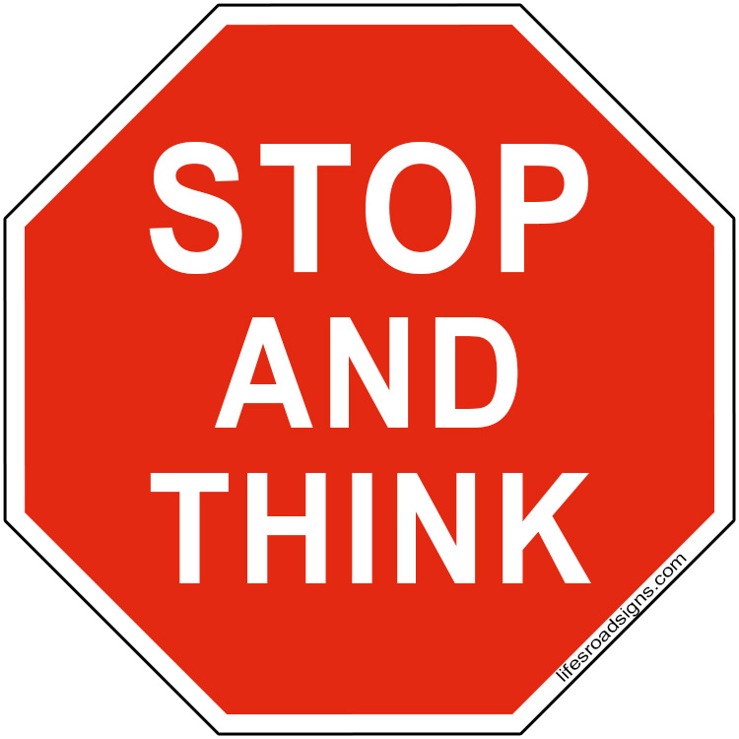
ACTIVITY 1:
In TEAMS of 3, use the internet, a dictionary or your notes to complete the ‘retail terminology worksheet and define the following key retail terminology:
When you have finished, present your findings to the class and listen to other team’s definitions to complete your own worksheet.
TEAM A | TEAM B
Customer Store Assistant Returns Faulty Goods Sale or Return Consumable Item Receipt Shoplifting Footfall Average Transaction Value Stock Loss | Repeat Sales Merchandising End of the Line Batch Products Sale of Goods Act Statutory Rights Guarantee Warranty Store Standards Product Groups Store Hygiene

Slide 5
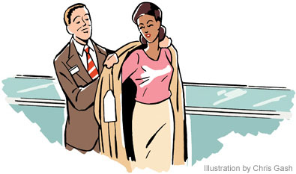
RETAIL PRACTICES
Greeting the customer
Approaching the customer
Identifying customer needs
Overcoming objectives
Closing the sale
Add on sales
Up-selling

Slide 6
1. Greeting the customer
How many times have you heard these words from ‘sales’ people at a retail store?
Hi! How are you…!
Can I help you?
Are you looking for something particular?
How can I help you?
The purpose of any sales greeting is to establish positive communication with the customer so you can qualify their needs.
The greeting is the beginning of the actual sales process. It makes the customer feel welcomed and comfortable in the store!

Slide 7
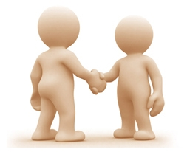
2. Approaching the customer
When a customer first walks through the door of your store, they want to feel comfortable and relaxed. All too often, though, customers feel under pressure to buy or are totally ignored. In order to make a sale you first have to approach and the customer.
Why Greet? –to make your presence felt, make the customer feel important
When to Greet – after the customer is comfortable in the store, when looking around for help
Whether to approach or not – leave the customer alone if he/she does not need assistance
How to greet – Politely, not in a hurried manner, choose the correct language

Slide 8
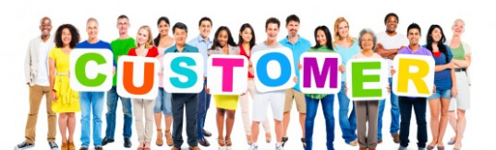
3. Identifying customer needs
Once you have identified who your customers are, you need to assess what they need from your product or service.
Most customer needs can be divided into four basic categories:
The need to be understood
The need to feel welcome
The need to feel important
The need for comfort
By knowing who your customers are, you are more able to meet their needs

Slide 9
4. Overcoming objections
Often customers may express concerns or objections about buying. It is important to know how to overcome these objections. Properly handled, most customer objections are actually steps to the sale!
Here are a few tips to help you overcome objections:
Do not use canned sales techniques- customers can see right through it!
Validate the objection- Always validate the objection and never argue or disagree with the customer. Repeat back the objection. NEVER respond to the objection immediately.
ASK a question! The best way to deal with an objection is to ask a question. Here are six powerful words that is important to a salesperson’s life. Who? What? When? Why? How?
Find the real concern and help solve the customers problem. Treat the objection as questions and uncover the solution.
Prepare common objections by writing them down. Anticipate those objections and be prepared to solve them with the customer.

Slide 10
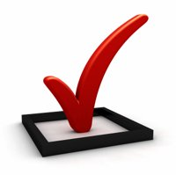
5. Closing the sale
the aim of opening any sale is to close it. All the efforts being made during the sale, right from the greeting to the actual sale would go waste if the sales person messes up at the closing stage.
Some examples of sales closing techniques -
The direct close: when the customer is asked directly about his buying decision. Like,
“Shall I pack this up, sir?”
“Would you like to buy this kurta?”
“Shall I make the bill?”
The assumption close: when the customers body language indicates that he has already made the purchase decision. Example, “how do you wish to pay for this?”
The limited choice close: giving the customer a limited positive choice to make the buying decision easier, more so when the customer is not able to make up his mind. Like, “which will it be, sir, the suede or the leather jacket?”
The suggestion close: when the buyer requires a gentle push towards the final purchase decision. For instance, “may I suggest that you go for the black trouser since it can be worn with just about every color”.

Slide 11
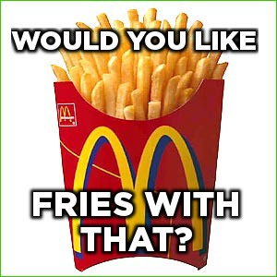
6. Add on sales
A sale of additional goods or services to a buyer. An add-on sale is generally suggested by the salesperson once the buyer has made a firm decision to buy the core product or service.
Q: where would you hear this add-on sales phrase?
Q: can you think of any places you visit where they practice add-on sales?

Slide 12
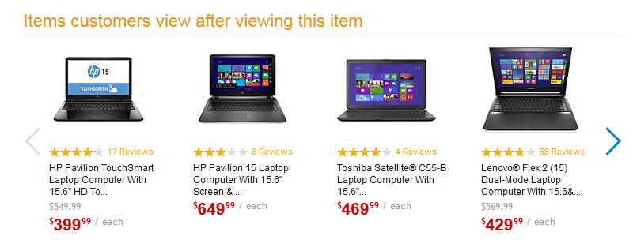
7. Upselling
Similar to add-on sales, Upselling (sometimes "up-selling") is a sales technique whereby a seller induces the customer to purchase more expensive items, upgrades, or other add-ons in an attempt to make a more profitable sale.
Example:

Slide 13
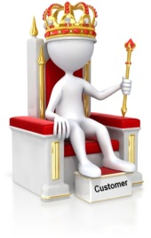
CUSTOMER SERVICE
Q: What do you think is meant by ‘customer service?’
Customer service:
the assistance and advice provided by a company to those people who buy or use its products or services
No matter the size of your business, excellent customer service needs be at the heart of your business model if you wish to be successful. It is important to provide good customer service to all types of customers, including potential, new and existing customers.

Slide 14
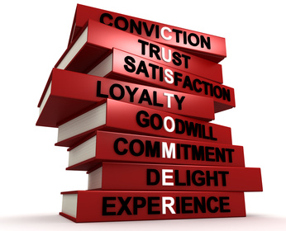
Why is Customer Service important in retail?
Julian Richer thinks that there are four main reasons why good customer service really makes a difference to a retail.
Good customer service is the cheapest and by far the most important form of advertising
Customer service is a differentiating factor – from the competition
Good service makes customers return
Good service prompts impulse buying

Slide 15
ACTIVITY 2:
Complete the ‘describing customer service’ worksheet.
Complete the ‘Discussing customer service’

Slide 16
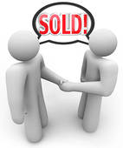
RETAIL SELLING
Q: What is retail selling?
Retail selling involves face-to-face communication between salespeople and customers in a retail business.
In simple retail selling transactions, sellers simply assist buyers in finding the right product to match a stated need. Effective retail sellers often find opportunities to suggest add-on sales of similar products or cross-sales of different products.

Slide 17
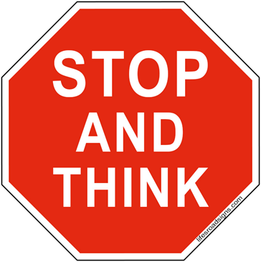
ACTIVITY 3:
Complete the ‘retail selling’ quiz

Slide 18
Retail sales techniques
Watch the following video, write down the different techniques described:

Slide 19
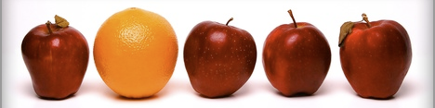
UNIQUE SELLING POINT (usp)
The factor or consideration presented by a seller as the reason that one product or service is different from and better than that of the competition is called the UNIQUE SELLING POINT (USP). It was developed by r. Reeves in the 1940’s.
In simple terms, USP is a method of persuading potential customers that your product offers a specific and unique benefit they cannot otherwise obtain.

Slide 20
Essential elements to the USP
Watch the following video and write down the 6 points

Slide 21
ACTIVITY 4:
COMPLETE THE ‘UNIQUE SELLING POINT’ quiz

Slide 22
End of unit 2

Slide 23
SOURCES
http://www.tutor2u.net/assets/retailcafe/induction/matchingcards.pdf
http://www.slideshare.net/dvdsalesmarketing/retail-sales-training
http://www.investopedia.com/terms/a/add-on-sales.asp
http://www.mowe.org.uk/docs/cs/Approach_customer.pdf

