Slide 1
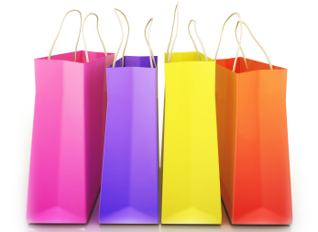
UNIT 1: Introduction to Retailing
4N1189 Retail Sales Techniques
RTS1: Explain the key principles of the retail environment in relation to customer care and retail selling

Slide 2
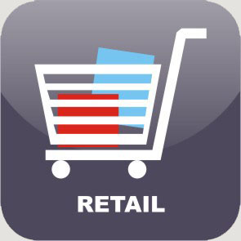
Introduction to Retailing: Topics
What is retailing?
Principles of Retail
Retail Markets
‘Brands’

Slide 3
What is retailing?
Retailing is the business where an organisation directly sells its products and services to an end consumer for personal, family or household use.
By definition whenever an organisation, be it a manufacturing or a whole seller, sells directly to the end consumer it is actually operating in the Retail space. It is the final link in the chain of production.
SUPPLY CHAIN:
Q: How many people do you know that work in retailing?

Slide 4
What is retailing?
It is an Industry which is heavily dependent on consumer spending . In this system consumers (money spenders) play the most important role.
Retail sales is generally driven by people’s ability (disposable income €€€) and willingness (consumer confidence) to buy goods and services.

Slide 5
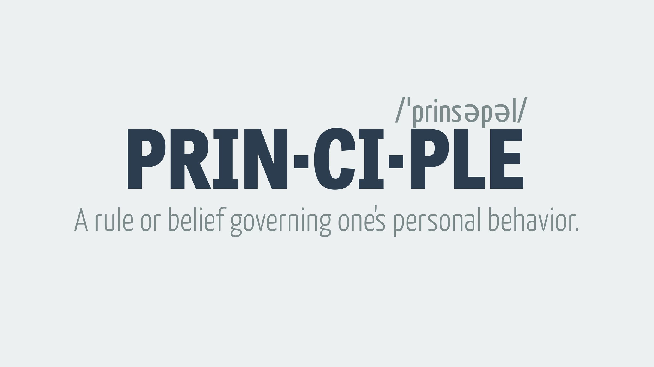
The Principles of Retailing
There are 5 principles underpinning retail, they are:
1. The customer is the most important person in your business
2. Retail is Detail
3. The 4 P’s
4. Go the Extra Mile
5. Location, Location, Location

Slide 6
The Customer is the Most Important
The customer holds the key to every successful retail operation. There is no business without the customer.

Slide 7
Retail is Detail
One of the most famous principles in retailing is, “retail is detail” To run a successful business you must address and improve your understanding of your customer. To do this, every retailer must focus on the detail and get the detail right the majority of the time.

Slide 8
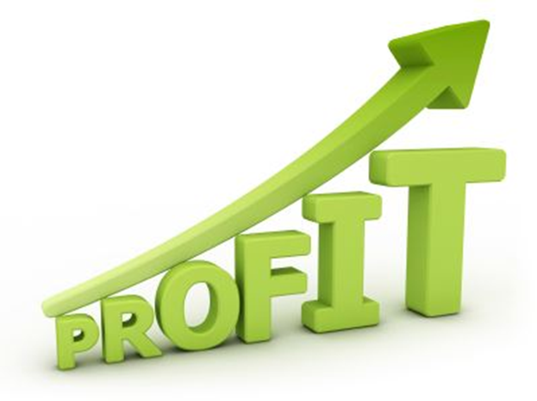
The 4 P’s
Product: You need products that your customers want to buy and a product range that will satisfy your customers’ needs and desires. The products must also deliver a profit for you to have a successful business
Price: Price must be consistent across the marketing mix and meet all requirements of a business. You need to price your products at the correct level for the customers to be able to buy your products, and for them to gain value from your products.
Place: You must provide somewhere for your customers to purchase your product, be that a physical store, a catalogue or an e-commerce site.
Promotion: Once you have a product — at the right price, in a place where the customer can access it — you need to tell them about it and promote your business and products; make sure your customers know that you and your products exist and are available for them to enjoy.

Slide 9
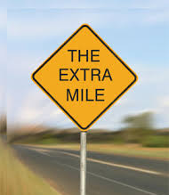
Go the Extra Mile
Providing great customer service starts with understanding and knowing your customer; however, knowing them is the start of the journey and you will need to deliver more than just customer service. To be successful you must you must “go the extra mile for the customer”. You and your team must continually go the extra mile for the customer, each time delivering just a little more than they expect. Doing this each time you and your team interact with your customers will win them over and make them loyal over a long period of time.
Q: What do we mean by ‘Go the Extra Mile’?

Slide 10
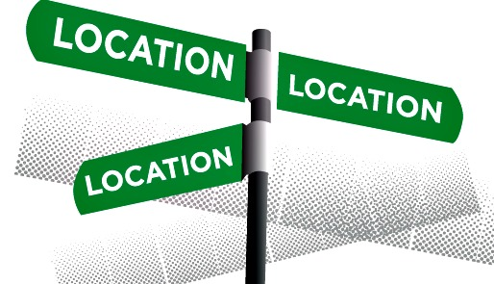
Location, Location, Location
The final retail principle is: Location, location, location. History has dictated that this is one of the most important factors in the success of a physical store, and still to this day it will have a major impact on your success. The best location of your store will be dictated by your brand and product strategies.

Slide 11
Activity 1:
Please complete the activity entitled ‘Principles of Retailing’

Slide 12
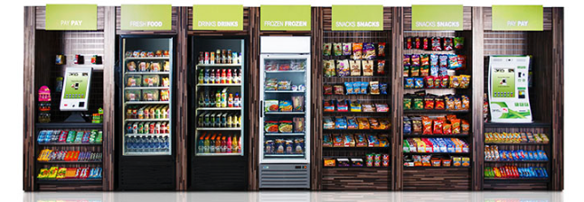
Retail Markets
There are several types of retail markets, the most common are:
Specialty Stores
Department Stores
Supermarket/Hypermarket
Convenience Stores
Discount Stores
Off Price Stores
Mom & Pop Stores

Slide 13
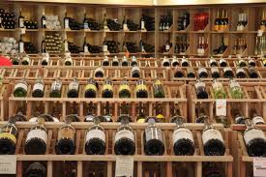
Specialty Stores
These stores are characterised by narrow product lines but with deep assortments such as Apparel Stores , Sporting goods store, Furniture store ,Florist and Book store. Under this also there could be specialisations like limited line store ( eg. Men’s clothing store) and Super specialty store (eg. Wine Store).
Q: Are there any specialty stores where you live?
Q: Can you name one in Ennis?

Slide 14
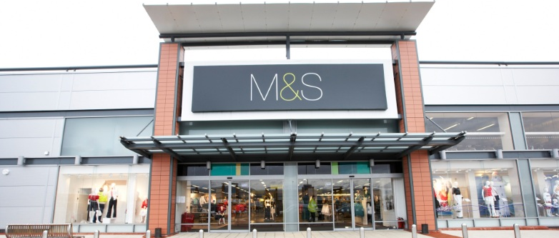
Department Stores
Several Product Lines –typically clothing, home furnishing and household goods with each line operated as a separate department managed by specialist buyers and merchandisers.
Example:
Q: Are there any department stores where you live?
Q: Can you name one in Ennis?

Slide 15
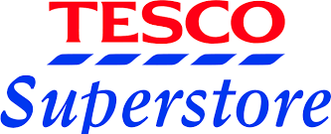
Supermarket/Hypermarket
Relatively large, low cost, low margin high volume, self service operation which is designed to cater total needs for food, laundry, household maintenance products .
Example:
Q: Are there any supermarket/hypermarkets where you live?
Q: Can you name one in Ennis?

Slide 16
Convenience Stores
These are the stores which are relatively small in size and they are located near residential area, normally remains open seven days a week and carrying a limited line of high turnover convenience products at slightly high prices. Many have added take away sandwiches, coffee and pastries.
Example:
Q: Are there any convenience stores where you live?
Q: Can you name one in Ennis?

Slide 17
Discount Stores
Standard merchandise sold at lower prices with lower margin but higher volumes. Actual discount stores regularly sell merchandise at lower prices and offer mostly national brands. In Discount retailing , Discount specialty retailing is also present e.g.. discount electronic store or discount book store.
Example:
Q: Are there any discount stores where you live?
Q: Can you name one in Ennis?

Slide 18
Off Price Retailers
Merchandise bought at less than regular wholesale prices and sold at less than retail prices. Often left over goods , irregulars obtained at reduced prices from manufacturers and other retailers.
Factory outlets are owned and operated by manufacturers and they normally carry manufacturer’s surplus, discontinued and irregular goods
Q: Are there any off price retailers where you live?
Q: Can you name one in Ennis?

Slide 19
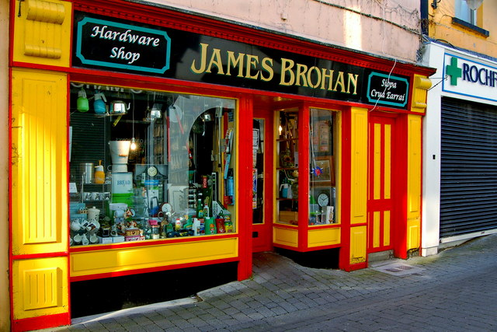
Mom & Pop Stores
Local neighbourhood stores managed by an independent, which provides limited range of daily use articles. Many such outlets are still thriving by knowing their customers better and providing them with more personalised service.
Example:
Q: Are there any mom & pop stores
where you live?
Q: Can you name one in Ennis?

Slide 20
Activity 2:
1. Complete the worksheet ‘Best Places to Buy’

Slide 21
‘Brands’

Slide 22
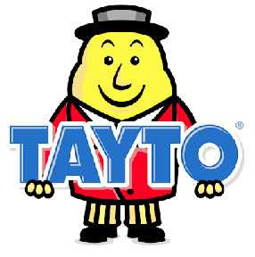
What is a ‘Brand’?
A name, term, sign, symbol, or design used to identify the products of one firm and to differentiate them from competitive offerings.
Something used to show customers that one product is different than the products of another manufacturer

Slide 23
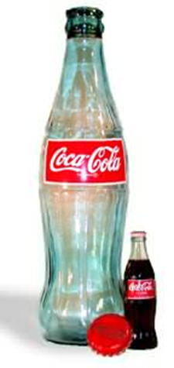
What do ‘Brands’ Mean to Regular People?
In 'blind' taste tests, people prefer the taste of Pepsi over the taste of Coke. However, if the test is not 'blind' and the tasters know which beverage is which, they prefer the taste of Coke over Pepsi! That is the emotional power of a brand.
The first shape that was registered is the coca cola bottle.

Slide 24
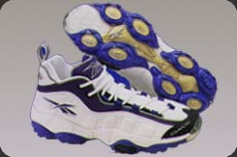
Brand Names
Words, letters, or symbols that make up a name used to identify and distinguish the firm’s offerings from those of its competitors.

Slide 25
Activity 3
Complete the ‘Retail Brands’ Worksheet/Activity
What are your top 5 favourite brands?
1. ____________________________
2. ____________________________
3. ____________________________
4. ____________________________
5. ____________________________

Slide 26
End of Unit 1

Slide 27
Sources
http://www.marketingdonut.co.uk/marketing/marketing-strategy/the-five-principles-of-retail
https://www.teachingenglish.org.uk/sites/teacheng/files/branding%20and%20brand%20names-worksheets.pdf
http://www.tutor2u.net/retail/induction.php

