Slide 1
Adult Literacy Awareness for Further Education & Training
Session 6
Integrating Literacy
Notes:
5 minutes
Welcome all back, take feedback from any extension activity, allow time for any questions from last week.

Slide 2
Extension Activity
Reflecting on a lesson you have already created, consider how would you integrate the principles of good literacy practice and Univeral Design for Learning to make the delivery more literacy-accessible.
Be creative about how the content is delivered.
Allow options for assessment that can play to a variety of learning styles.
Notes:
15 minutes
Welcome all back, take feedback from any extension activity, allow time for any questions from last week.
Recap on the extension activity from session 5. We will be using a Menti to take some written feedback and there will be time for discussion then.
Introduce the Menti, which should take the format of an “Open Ended” Menti with the question "Reflecting on a lesson you have already created, consider how would you integrate the principles of good literacy practice and Universal Design for Learning to make the delivery more literacy-accessible. Be creative about how the content is delivered. Allow options for assessment that can play to a variety of learning styles."
Share the Mentimeter.com presentation on screen so that all participants can: (1) see the menti code to enter, and (2) see other participants' submissions.
As submissions appear identify emerging themes. Identifying themes, ask participants to elaborate on their ideas and to ask questions of the facilitators to deepen their awareness and practice in particular areas. Allow some time for discussion amongst the group.
There will not be time to take verbal feedback from every participant. Reassure participants that they can follow up with the facilitators after sessions.

Slide 3
Aims Session 6: Integrating Literacy
Explore
the value of integrating literacy across curriculum and courses, accredited and non-accredited
Query
Hear ideas
for whole centre and classroom based integration approaches
responsibility for literacy integration
Notes:
3 minutes
Explain the session aims for this session. Note that at the time of writing, the 10-year Adult Literacy Numeracy & Digital Literacy Strategy for Ireland had not been published, nor the ETBI Framework for Literacy Integration, so this session may require ongoing updates.
Look to the NALA guidelines for whole centre integration.

Slide 4
Why consider integration of literacy?
Aim of this session to explore the value of an integrated approach to literacy
What does literacy awareness and integration look like:
In PLCs or Training Centres, where learners are generally working towards qualifications in vocational or subject specialist areas
In the Community Education setting, where learners may be taking courses with minimal amounts of written coursework
Notes:
5 minutes
Literacy awareness and integration approaches can vary. For the PLC teacher/Training Centre instructor, it may include looking at the language used in course handouts/briefs and querying whether this can be made more accessible. Or it may include integration across curricula, which would take a ‘whole centre’ approach, to be discussed further in later slides.
In some ETBs, there may be standalone supports offered by a local Adult Literacy Service to a local PLC or Training Centre. This can be in the form of advice and support from the Adult Literacy Organiser (ALO), but can in some instances include support literacy/language/numeracy classes offered by the ALO. Integration of literacy in colleges and centres is key to ensuring the participants are comfortable with the academic demands of their course and not overwhelmed by the reading/writing/numeracy/IT demands of the course.
Literacy awareness in the Community Education sector widens participation and can open dialogue around literacy needs. It can foster a relationship between subject specialists and literacy practitioners, thereby supporting the subject specialist in meeting learner needs. It may be that a Community Education tutor, teaching art for instance, becomes aware of the difficulties an adult has with filling in a registration form for instance, and liaises with the ALO on approaches to managing this, opening conversations about literacy classes and appropriate referral approaches. It may include awareness about using plain English on posters or flyers advertising courses. It may include being aware that talking through handouts helps the learner understand the content, and how supporting visuals help too.

Slide 5
Why integrate? – Policy developments
The FET Strategy (2020-24)
Learner supports
Integrated service
Emerging themes in the ALNDS Strategy
Literacy awareness
Integrated supports
EU key competences (2018) Integrating literacy supports development of competences which are transferable – to the workplace, further study, personal goals and everyday life
Notes:
3 minutes
The FET Strategy 2020-2024 (p. 48) states that integration of literacy is one of the keys to addressing unmet literacy needs in Ireland. Among the aims of the strategy are; raising literacy awareness, developing broad standards at level 1-4 (recognising that explicit cohort of learners’ needs) and integrating literacy at levels 5 & 6.
Emerging themes in the research for the 10-year Adult Literacy, Numeracy and Digital Strategy include raising literacy awareness nationally, and so to raise it within our ETBs is a good starting point. Integrating literacy across curricula also emerged as a theme.
The EU Key Competences (2018) point to a range of competences required to partake fully in society. These include literacy, numeracy and digital skills competences.
solas_fet_strategy_web.pdf

Slide 6
Why integrate? – Learner experience
Knowing the literacy statistics in Ireland – there is a likelihood that there will be some learners in your classroom/group who have unmet literacy needs
A culture of inclusion and care ensues
Increased learner motivation - learner success in early assignments can be built upon throughout the course/academic year
The learner gains the skills and confidence to complete the course - learner retention is increased - increased certification rates
Learner reflects on perception of self, critical thinking increases, increased confidence
Notes:
4 minutes
It is statistically likely that a proportion of learners in your classroom have unmet literacy/numeracy/digital skills.
There is a large body of evidence (see FESS site for a range of reports and useful links to supporting resources) , including a number of papers by Thomas Sticht that demonstrate that adult learners improve their literacy skills when they are relevant to their immediate lives, and this includes their vocational education. An ETBI paper on integrating literacy into FET lists some of the benefits of integrating literacy to include:
Higher retention rates
A higher proportion of learners achieving vocational qualifications
A higher proportion of learners achieving language, literacy and numeracy qualifications
Students reported that they are better prepared for future job roles (Casey et al, 2006)
Integrating literacy benefits all learners, not just those with difficulties, and creates a culture of inclusion and care for the learner.
https://www.fess.ie/resource-library/literacy-and-numeracy
https://www.halloffame.outreach.ou.edu/inductions/hof-2013/sticht/
https://www.etbi.ie/wp-content/uploads/2017/11/Updated-ETBI-Intlit-doc.docx

Slide 7
Discussion
In your experience, have you noticed learners struggle with any aspect of the literacy demands of the course you deliver?
If so, how did you manage the situation?
As an educator, how did you feel in this position?
Notes:
5 minutes
A question to the floor:
In your experience, have you noticed learners struggle with any aspect of the literacy demands of the course you deliver?
If so, how did you manage the situation?
As an educator, how did you feel in this position?
Educators can feel frustrated and helpless when they are unsure of how to support learners, validate these as normal concerns.
Assure educators there are tips to support literacy within their classrooms and groups.

Slide 8
Commonly reported difficulties
Diagnosed Specific Learning Difficulties (Autism, Dyslexia, Dyscalculia)
Comprehension challenges (difficulty understanding texts, questions or briefs)
Writing difficulties – structuring sentences and paragraphs*
Language (either speaker of another language or unfamiliar technical terms)
Notes:
10 minutes
In our experience supporting the PLC sector, some common issues are reported by both the teacher when referring, and the learner themselves. Some of the difficulties (or barriers to completing assignments successfully) are:
Specific Learning Difficulties (SpLDs) are sometimes conflated with literacy difficulties. It may indeed be the case that an individual’s SpLD has caused difficulty with reading or spelling for instance, but it is not always the case. A learner with Dyslexia, for example, does not necessarily need literacy supports. They may need other supports, such as digital or technological supports or they may need special accommodations around examinations or how they present work. It is important not to automatically assume a learner with an SpLD will need literacy support. As with all learners, a conversation about how they have managed thus far will give a good indication of the supports (if any) they require.
Comprehension challenges. Reading is not purely a word recognition skill, it is more importantly about meaning. Literacy practitioners have worked with learners who seem to read fluently, but when questioned on the content of the text, they cannot answer or answer incorrectly. Reading for fluency and reading for meaning are distinct skills, and it may not be immediately evident that a learner has difficulty comprehending what they are reading. It is important to test comprehension of texts and we will discuss how in the next slide.
Writing challenges. Academic writing skills take time to perfect. To a lot of learners new to PLC or trade courses, while the subject matter is new, so too is the expected style of writing. There can be an overwhelming amount of new information for the learner to take on. Taking time to explicitly talk through expectations of the format and language expected when presenting assignments is important. A class or two on academic writing also helps. Explaining terms in briefs can support the learner to get started on assignments, such as ‘Describe…’, ‘Evaluate…’ ‘Compare and contrast….’ The booklet ‘Academic Writing for Learners in the FET sector’ developed by FESS and ETBs has lots of tips and is an essential guide for learners. The writing and referencing resources on these sites will be useful if actively referred to throughout the year by teachers and learners.
Language in FET
Different groups, different identities, different literacies and language. A useful website to look at language in FET is:
Language, literacy & numeracy in VET | Learning Lab (rmit.edu.au)
We have public and personal personas. We have language we use in those domains and know which is appropriate for each. For learners coming in to a formal, or non-formal, learning space, there will be a new identity and language and literacy demands attached.
Every vocational, trade or hobby course has specialist language attached. The experienced subject teacher is often an ‘expert’ in this specialist language, so is highly literate in the area. In this sense, the literacy is attached to not only reading the words of the specialist subject, but understanding them and knowing how to use this vocabulary when responding to tasks, assignments and exams. As the language is everyday language to the teacher, they may not always notice the demands this new vocabulary is placing on the learner. Handing out, and talking through, glossaries of words and terminology relating to the course at the start of the course is very useful. Encouraging use of that terminology from the start of the course increases the learner’s confidence in using this new language and making it their own.
https://www.fess.ie/resource-library/writing-and-referencing-resources
ESOL Learners:
It is important to emphasise that for bilingual learners, repeated exposure to new words and terminology of an academic nature is not sufficient in itself to develop their own active vocabularies. Although it is important for students to frequently hear and read new words and concepts, it is only through additional practice of using these terms, both orally and in writing, that students will actively take ownership of academic vocabulary and become more confident about using subject-specific terminology.

Slide 9
More reported difficulties
Access to technology devices to produce the work required
Confidence/beliefs about the self, relating to some/all of the above
The processes involved in managing academic material, learning and producing coherent responses to tasks required (learning to learn)
Notes:
5 Minutes
Access to devices/technological ability
We know that the digital divide is not only something that reflects the gaps in knowledge of what can be accessed online, but that it also reflects the divide between those who have good internet access and digital devices. It is not unusual to see learners attempt to type assignments on smartphones for instance. Recent availability of laptops to the FET sector has gone some way to addressing the issue, but there remains a way to go. It is also often assumed that the younger generation, who have grown up with social media, are adept with software packages. This is often not the case, and learners have to be taught to use common word processing packages, email platforms, file management and storage.
Confidence and beliefs about the self
When a learner has a literacy difficulty, they often internalise this as being their fault. Individuals often use terms such ‘I feel stupid’ when revealing literacy difficulties. It is important to reassure learners that literacy difficulties are not related to intelligence, but more often due to missed opportunities out of the control of the individual. They often feel they are the only one who has this difficulty. It is important to reassure the individual that literacy difficulties are common, and that with practice and support, can be overcome.
Learning to Learn
There is a lot to learn for a new FET student, and in the early weeks of course they can feel overwhelmed. It is helpful to remember that the learner who is struggling with literacy, be it reading, writing, numeracy or digital, needs to be supported and scaffolded (Vygotsky’s ZPD – what I learn myself, what I can learn with help, what is beyond my capacity at the moment) before they can produce work independently. One way to approach this is utilising Bloom’s Taxonomy.

Slide 10
5 Minute Break
Notes:
5 Minutes

Slide 11
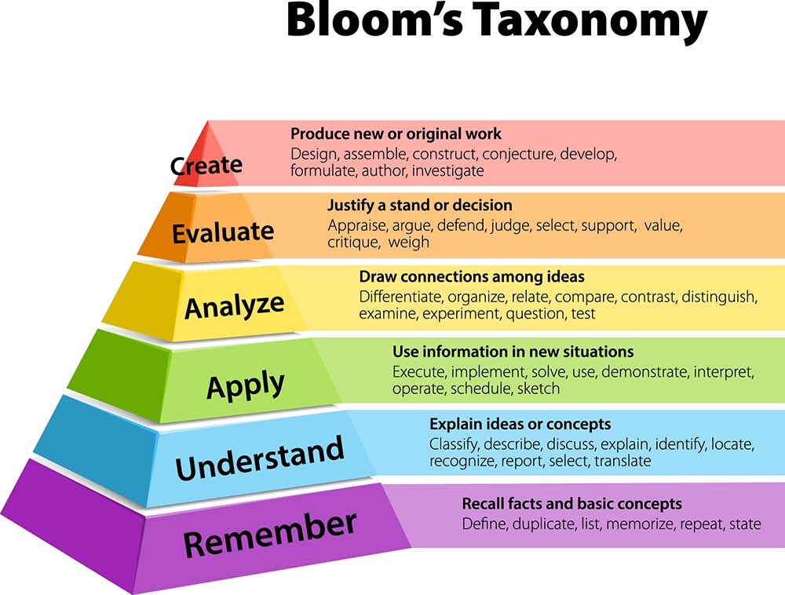
Notes:
5 minutes
If we look at the six verbs in the pyramid, note the bottom three are related to lower order thinking skills and the top three to higher order skills. If the learner needs to simply read and remember something, they are using lower order thinking skills. So too if asked to demonstrate their understanding through presenting something they have read in their own words, for instance writing short report on a topic they are researching, and knowing how to reference if quoting. Application of a theory/equation is more complex, but still regarded as a lower order skill. The three higher order skills are actually quite complex thinking skills, they are thinking skills learned over many years of study, possibly formed in senior cycle in secondary school and on in to university education. Not all learners will come to FET with these skills.

Slide 12
Utilising Bloom’s Taxonomy when creating briefs and assignments
When writing or devising the task/assignment: Think about the learning outcome and whether the evidence requires a demonstration of understanding or something more complex, structure questions according to the verbs in Bloom’s Taxonomy
When writing the brief: Think of a brief as the scaffolding a learner requires to attempt their assignment and task, use plain English, and step by step clear instructions
Notes:
5 minutes
When devising assignments and briefs, it is useful to keep Bloom’s verbs in mind. Simply written briefs do not take away from the complexity of the assignment. It may be the case that the learner must produce a piece of critical analysis, which is a higher order skill, however the brief can be written in plain English (which we will discuss next week) to help the learner understand what is expected of them. There can be a misconception sometimes that the language used on a brief must equate to the complexity of the task required, but often that is not the case. Briefs can be written so they are the scaffolding the learner requires in order for them to independently approach assignments.

Slide 13
What can the classroom teacher do to integrate literacy?
Be literacy aware, expect that some learners are having literacy difficulties
Encourage dialogue as much as possible, encourage questions
Try a non-threatening scan for literacy/numeracy difficulties (Handout 4.1)
Identify the literacy demands of the course - create a glossary of terms and useful vocabulary
Explain how to read (skimming, in-depth reading, note-taking while reading)
Notes:
10 mins
Talk through the list on the slide, encouraging in particular dialogue. Remind the participants of Freire’s approach to teaching, avoiding the ‘jug & mug’ didactic approach and encouraging more discussion and group work. With a new group, teachers might want to find out what the learner already knows, or find out where the gaps are in their learning. This can be done through a variety of classroom based activities, such as a True/False activity. Talk through the method in handout 6.1. From such activities, the teacher may find out they have to ‘pre-teach’ some elements of the course, or create a glossary of terms/vocabulary relating to the course.
Teachers can get lots of ideas, and there are existing materials to support the FET teacher, on the FESS website at https://www.fess.ie/resource-library/literacy-and-numeracy
Explain that the next two sessions will give explicit ideas to support reading, writing & numeracy supports, but that for the moment, remember the following:
reading skills vary according to the task and it helps to explain to the learner which reading skill is required will support them, e.g. do they need to skim for factual information, do they need to note take while reading so they can reference later in an assignment, do they need to read something a number of times to evaluate it and form their own opinion?
Writing good assignments is a skill which will develop over the course with good feedback. Explain to the learner that a well written assignment starts with reading the brief to understand the requirements, creating a mind-map of ideas to organise thoughts, and putting these ideas into a first draft. Explain to the learner that each sentence should go some way to answering the question, and to write with the question in mind. Remind the learner to refer to the ETBI/FET guides to writing and referencing.
Depending on the ETB and location of services, there may be an opportunity to avail of the support of your local literacy service. Adult Literacy Organisers may have resources to support teachers/centres.

Slide 14
What can the classroom teacher do to integrate literacy?
Explain writing approaches (explain mind-mapping, drafting, final versions)
Create templates to scaffold assignments
Use Bloom’s taxonomy to scaffold the learner
Know that this approach will be appreciated by the learners
If it is available in your service, seek support from a literacy specialist
Lots of resources available at: https://www.fess.ie/resource-library/literacy-and-numeracy
Notes:
3 minutes
The participant may have taken the whole 6-week course, or may just be taking this session as a standalone. If part of the course, refer the participant back to How Learning Works to remind them of a variety of approached to reading. If not, the participant may need skimming, scanning and other reading methods explained.
If all assignments and briefs have a similar template, the learner gets used to what is being asked of them. Use Bloom’s taxonomy to support writing the briefs and assignments.
Take heart that your learner will appreciate the efforts you are going to and seek support from a local literacy service if you require more direction or help.

Slide 15
Whole centre approaches to integration
Who is responsible for literacy integration?
The centre decides who will develop and manage the whole centre approach to literacy integration
A team is set up to draw up a policy for integration, this might involve programme managers, learning support staff, guidance staff
A link is formed with a literacy specialist (local Adult Literacy Organiser)
The centre, supported by the ALO, provides training on literacy awareness and integration
The approach to integrating literacy and numeracy is decided on and monitored
Possibility of ongoing support from ALO, depending on local services
ETBI Framework, NALA Guidelines
Notes:
10 minutes
At the time of writing ETBI had not yet published an anticipated framework for literacy integration in FET. However, there are existing models in practice and numerous resources available. NALA have completed work on a resource for integration which is available both on their website and through the FESS link.
When we look at who might be responsible for integrating literacy throughout FET programmes there are four approaches, all dependent on each other:
Policy makers
Programme developers/writers
FET centres – Heads of centres, literacy integration teams
Teachers/facilitators
Ultimately, successful integration is dependent on all of the above. This slide aims to take a glimpse at a whole centre approach, but it is not the aim of this course to dictate how any centre/ETB might approach literacy integration. A whole centre approach takes long term planning, cooperation of all staff and support from literacy specialists. This slide however aims to give an overview of an approach for consideration.

Slide 16
Breakout room
Reflecting on opportunities for integrating literacy within the class setting and within your wider organisation, identify some practical ways that you could support the integration process.
What challenges exist to integrating literacy in the further education and training sector?
Notes:
24 minutes
2 minute Intro
10 minutes in Breakout Room
3 minutes / group x max 4 groups
Introduce the Breakout Room.
Task:
Reflecting on opportunities for integrating literacy within the class setting and within your wider organisation, identify some practical ways that you could support the integration process. What challenges exist to integrating literacy in the further education and training sector?
Group 3 or 4 participants to each room. Groups should identify one person to takes notes and feedback from the task at the end.
Give 8 minutes for discussion, with 2 minutes countdown time for the breakout rooms.
When the breakout rooms close, give 3 minutes to each group to share their feedback and discuss new approaches and ideas encountered.

Slide 17
Course Evaluation
6 Sessions
1. Literacy Landscape, Theorists
2. Theorists, Causes and Impacts of Literacy Issues
3. Literacy Awareness & Creating a Literacy-Friendly Environment
4. Boundaries and Referrals
5. How Learning Works, Tips & Tools
6. Integrating Literacy
Notes:
3 minutes
Introduce the Course Evaluation and do a quick recap on the areas covered over the last six session.
Place the link to the evaluation in the chat box and ask everyone to take a few minutes to complete it now.
Thanks everyone for their attendance and very valuable and insightful inputs.
Ask for any final questions before closing the session.
Make your contact details available once more and ensure that participants know that they can contact you and your team for support and advice with all things literacy-related at any time.

