Slide 1
The external authentication process in programmes leading to awards as described in the QQI Professional Award-type Descriptors (PATDs)
Notes:
This presentation will focus on the external authentication process in programmes leading to awards as described in the QQI Professional Award-type Descriptors document.

Slide 2
This presentation
There are 12 slides
The presentation takes approximately 27 minutes
The aim of this presentation is to build on your knowledge of the external authentication process, with specific reference to working as an external authenticator in programmes leading to awards as described in the QQI Professional Award-type Descriptors (PATDs)
Notes:
This presentation will build on the knowledge gained during the original two-day training undertaken by all those listed on the EA National Directory. It would be useful to have the folder from the two-day training event to hand while working through this presentation as reference will be made to the original Powerpoint presentation and some of the other handouts in that folder. However, if you do not have the folder to hand, all references to the folder will include a screenshot of the relevant document or slide on the screen.
The main focus of the presentation is on the QQI Professional Award-type Descriptors, which are sometimes called the PATDs and which are available for download on the QQI website.

Slide 3
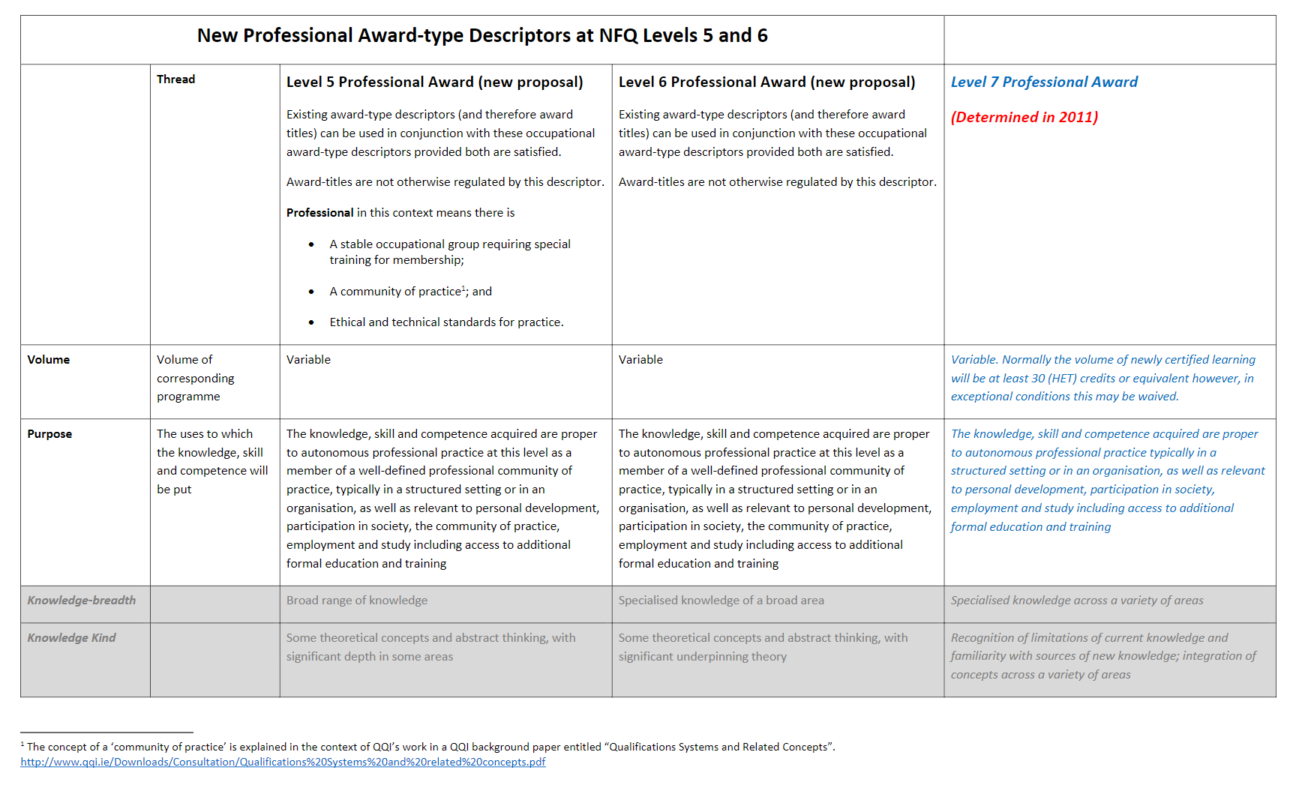
QQI Professional Award-Type Descriptors
This document can be found in the folder provided at the beginning of the two-day EA training event
that you previously attended
Notes:
The detail relating to QQI’s professional awards is contained in a document called Professional Award-type Descriptors (Award Class: Professional) For the Alignment of Professional Awards at NFQ Levels 5, 6, 7, 8 and 9.
QQI has also published another variation of the Professional Award-type Descriptors, which are sometimes called the PATDs document for those providers, including ETBs, developing programmes at levels 5 and 6 only. Both documents contain the same information in relation to level 5 and level 6 professional awards. The detail relating to level 7 awards is also provided in the levels 5 and 6 document, for reference purposes.
A copy of the levels 5 and 6 Professional Award-type descriptors was included in the folder provided to you at the original two-day external authenticator training event and can be found after the second last tab in that folder.
In essence, the descriptors provide, among other things, general statements of standards that are used as a guide by providers when developing a programme that would be consistent with those standards. Within the FET sector, the application of these Professional Award-type Descriptors has been through the development of apprenticeship programmes. For that reason the majority of this presentation will focus on apprenticeship programmes with a short introduction to annotated Professional Award-type Descriptors towards the end of the presentation.

Slide 4
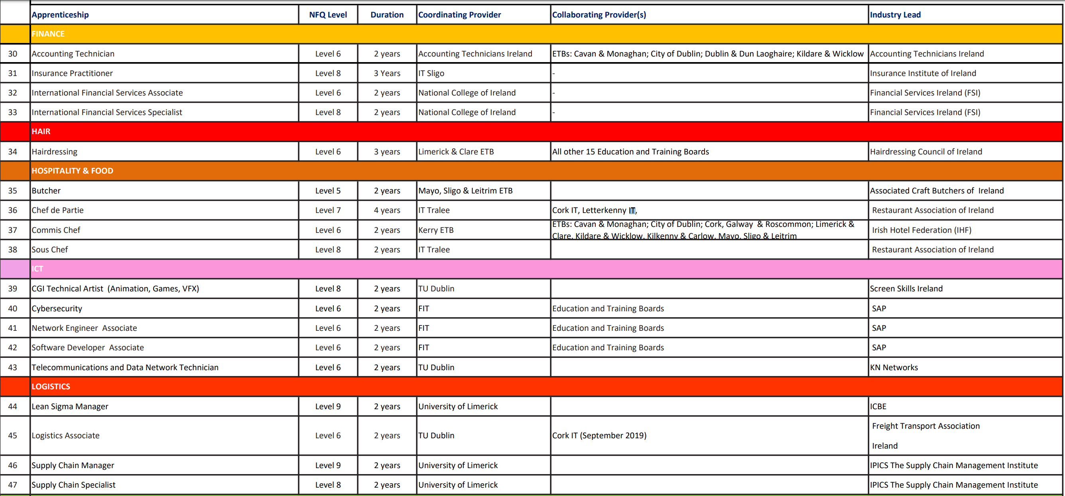
Notes:
Slides 94 to 101 touched on apprenticeship programmes in the presentation used at the original two-day external authenticator training event. At that training we mentioned that the apprenticeship programmes we are focusing on for the EA national directory are the post 2016 apprenticeships. (animations 1-8)
The detail contained in this presentation regarding apprenticeship programmes are focused only on these post 2016 apprenticeships and do not include reference to the craft apprenticeships such as Carpentry and Joinery, Electrical, Plumbing etc.
It might be useful if you paused this presentation for a couple of minutes to refresh your memory about the contents of those slides and any notes that you might have taken on the day of the training.
There is a full list of apprenticeship programmes available for viewing on www.apprenticeship.ie. The list includes both apprenticeships that are up and running, as well as apprenticeships that are currently under development. It is for apprenticeship programmes where an Education and Training Board, or ETB, is listed as the Co-ordinating Provider, that an external authenticator may be chosen from those listed on the EA National Directory.
These apprenticeship programmes vary across many vocational areas, for example, OEM Engineering, Accounting Technician, Hairdressing, Butchering, Commis Chef, Autctioneering and Property Services, Sales and so on.

Slide 5
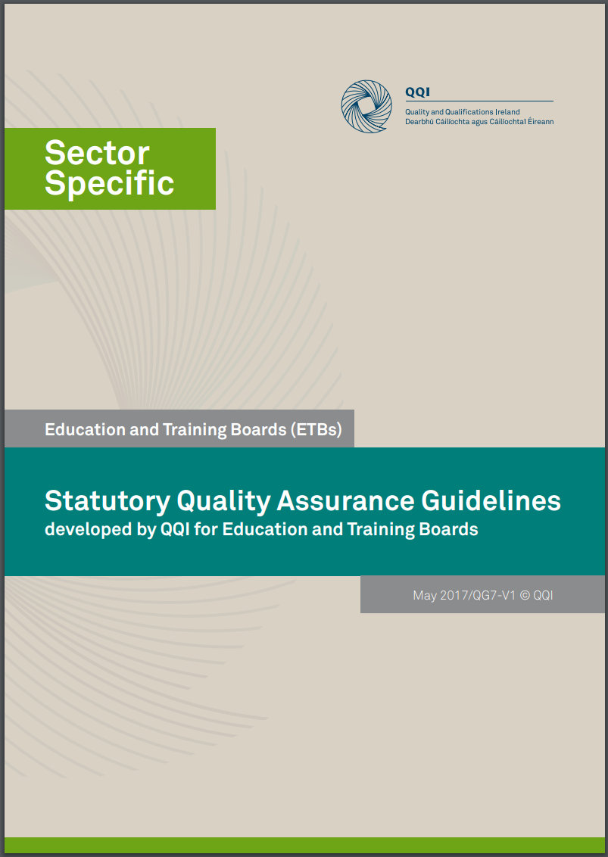
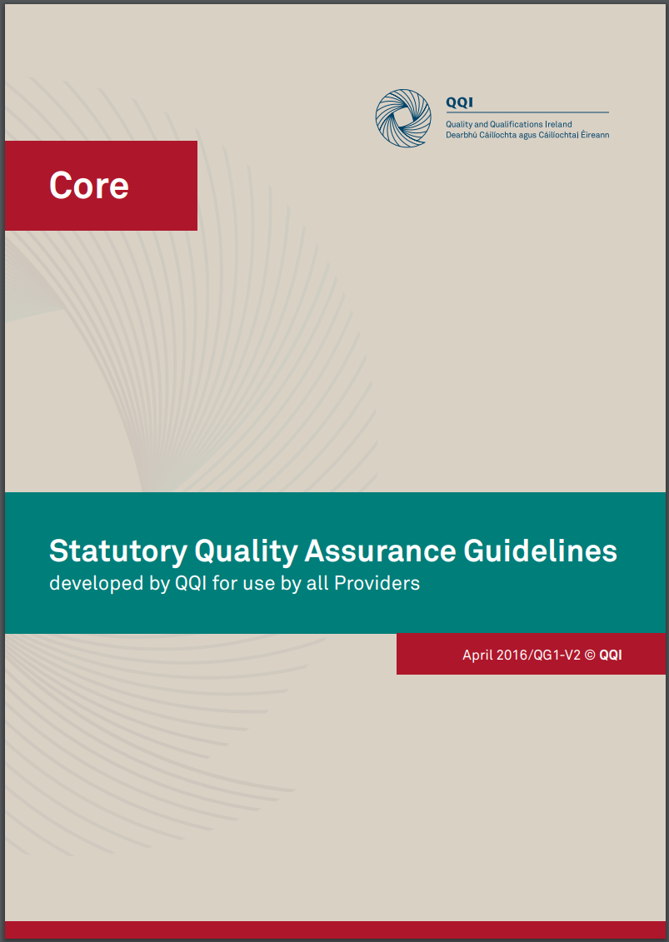
Quality Assurance
Adopt
Adapt
Notes:
Before we look at how the Professional Award-type Descriptors may inform the role of the external authenticator, it is important to remind ourselves that all providers who are offering programmes leading to QQI certification are quality assured.
We mentioned at the original two-day external authenticator training that it is a provider’s QA system that details the specifics for, among other things, the external authentication process.
If we look at the QA system for apprenticeship programmes, we should start by noting that in June 2016 QQI published Topic-Specific Statutory Quality Assurance Guidelines for Apprenticeship Programmes. These QA guidelines address the specific detail for the development, delivery and evaluation of an apprenticeship programme and they outline the expectations of QQI around quality provision, teaching, learning and assessment.
The expectation is that providers would use these guidelines in conjunction with QQI’s core QA guidelines and the relevant sector-specific guidelines, when documenting their QA procedures for an apprenticeship programme.
It is worth noting though that the development of apprenticeship programmes is a relatively new activity for the ETB sector. To support the sector in this work, Education and Training Boards Ireland, or ETBI, developed a set of quality assurance procedures, which became known as QAPs, that could be adopted or adapted by those ETBs responsible for developing the apprenticeship programme and its associated QA procedures.
In practice this means that there may be differences in how external authentication is planned, managed and executed across each apprenticeship programme. As the external authenticator it is recommended that you discuss the specifics around your role with the provider securing your services.

Slide 6
Co-ordinating and Collaborating Providers
Co-ordinating Provider – responsible for, among other things:
Providing the apprenticeship programme
Establishing a Programme Board (to steer the programme)
Development of the curriculum and assessment procedures
Maintenance of the curriculum and assessment procedures
Leading the collaborating provider(s)
Collaborating Provider:
Formally involved in the provision of the apprenticeship programme
Accountable to the Co-ordinating Provider, in respect of the apprenticeship programme
Notes:
We are used to talking about providers in terms of offering programmes leading to QQI certification. Apprenticeship programmes are different from other FET programmes in that there will always be a Co-ordinating Provider involved in the programme. A Co-ordinating Provider is taken to mean the provider, in this case the ETB, who is ultimately responsible for providing an apprenticeship programme and for establishing a programme board that will steer the programme. The Co-ordinating Provider is also responsible for developing and maintaining the curriculum of the programme as well as the assessment procedures.
It is common for an apprenticeship programme to be offered in more than one ETB. In this case, the Co-ordinating Provider may work with a collaborating provider or providers who will also offer the apprenticeship programme, but be lead by, and be accountable to the Co-ordinating Provider.
Further detail regarding Co-ordinating and collaborating providers, as well as the programme board, is provided in the QQI QA guidelines for apprenticeship programmes, if you would like to read more about the role of the different partners involved in the development, operation and maintenance of the apprenticeship programmes.

Slide 7
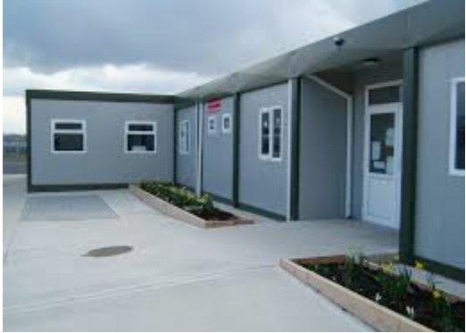
Co-ordinating and Collaborating Providers and the External Authenticator
Dates/times/venues
Volume of work
The role of the external authenticator is to provide independent confirmation of fair and consistent assessment of learners in accordance with national standards
Additional responsibilities may also include, to:
Agree assessment instruments and related documentation
Provide feedback to the assessor
Be a member of the Examination Board
Input to the Programme Board
The External Authenticator Report
Template provided by the Co-ordinating Provider
Completed and submitted to relevant provider
Made available to the Programme Co-ordinator, Programme Board and Examination Board
Sampling Strategy
Notes:
We mentioned in slide 100 of the presentation used at the original two-day external authenticator training event that when preparing for external authentication, certain terms and conditions should be agreed in advance with the Co-ordinating and/or collaborating providers.
We will take a moment to look at some of the points on the slide from the perspective of the apprenticeship programme being offered across a Co-ordinating Provider and one or more collaborating providers:
Dates/times/venues: It may be the case that the Co-ordinating Provider will secure the services of one external authenticator to confirm the fair and consistent assessment of learners across the Co-ordinating and the collaborating provider or providers. This scenario could mean that there would be travel required to different venues in different ETBs and possibly across a number of days
Volume of work: The learner portfolios to be authenticated by the external authenticator will be selected in line with the sampling strategy. It may be the case that each provider offering the apprenticeship programme has their own sampling strategy or there may be one sampling strategy agreed for the apprenticeship programme that would be applied across the Co-ordinating and collaborating providers
Other responsibilities: The role of the external authenticator, as detailed on slide 12 of the presentation used at the original two-day training event remains the same for apprenticeship programmes and is, in essence, to provide independent confirmation of fair and consistent assessment of learners in accordance with national standards. There are however other responsibilities that may or may not arise for you in the role of external authenticator for apprenticeship programmes, and these include:
Working with the Co-ordinating Provider prior to the rollout of the apprenticeship programme to agree the assessment instruments in the form of assessment briefs and/or examination papers and their related documentation such as marking schemes and outline solutions
Providing feedback to the assessor on the consistency of their assessment judgements across apprentices’ performances
Being a member of the examination board for the apprenticeship programme. This board will likely carry out a similar function to the results approval panel but the specific details regarding it would be contained in the QA procedures for the apprenticeship programme
Being available to the results approval panel. It may be the case that each provider will establish a results approval panel for their own local sign off of results, prior to the review and final sign off of all results by the examination board
Input to the Programme Board when the apprenticeship programme is being reviewed for its effectiveness and relevance
A template for the External Authenticator Report will be made available by the Co-ordinating Provider. It is important to note that the completed reports, as well as being issued to the provider for which the report relates, will also be made available to the Programme Co-ordinator, the Programme Board and the Examination Board

Slide 8
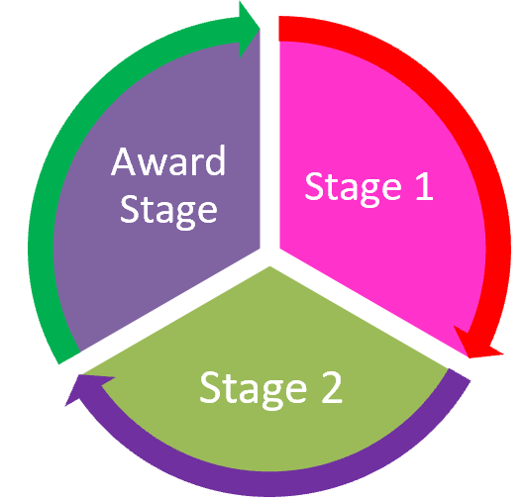
Post 2016 Apprenticeships
An apprenticeship is a programme of structured education and training which formally combines and alternates learning in the workplace with learning in an education or training centre
QQI Topic specific quality assurance (QA) guidelines for apprenticeship programmes
Minimum of 50% workplace based learning
Minimum of 2 years duration
Certification in the major award only (no individual minor awards)
Notes:
We mentioned during the original training that apprenticeship programmes alternate learning in the workplace with learning in an educational or training institution where a minimum of 50% of the duration of the programme will be facilitated in the workplace. Considering that each apprenticeship programme must be a minimum of 2 years duration, this obviously means that a considerable amount of time will be spent by the apprentice in the workplace.
In terms of working as an external authenticator this is important to know as there may be multiple approaches to the assessment of learners in the workplace, which may have a knock on effect on the types of evidence that is presented to you, for example:
The learner may be required to successfully demonstrate the execution of a number of tasks in the workplace in order to be eligible for certification. In some cases the execution of these tasks may carry no weighting in terms of contributing to a final mark or grade but in other cases, the execution of the tasks will carry a weighting and will contribute towards a final mark or grade
The learner may complete assessment tasks in the workplace but these may be marked and graded by the assessor in the educational or training institution or
The learner may complete assessment tasks in the workplace and these may be marked and graded by a member of staff from the employer who is facilitating the learner in the on-the-job elements of the programme or
The learner may be marked on their assessment tasks by both the assessor in the educational or training institution and the member of staff from the employer working together
As an external authenticator it is important that you see that there is consistency across the management, execution and grading of assessment tasks in the workplace and in the educational or training institution.
Sometimes apprenticeship programmes will be divided into stages, for example, an academic year, or a semester which would normally equate to half an academic year. It is often the case that progression to one stage is dependent on a learner being successful at the preceding stage. In this case It is likely that the services of an external authenticator will be secured at the end of each stage, so as to ensure that those learners progressing to the next stage of the apprenticeship programme have demonstrated the necessary standards to be eligible to progress.
It is worth noting at this point though, that even if your services as external authenticator are used in one of the stages of the programme where a learner has successfully completed a number of modules, this will often not result in the learner achieving certification in any minor or component awards. A learner who is successful in an apprenticeship programme, will typically only receive certification in a major award, namely a Certificate at level 5 or an Advanced Certificate at level 6. This is one of the main differences between apprenticeship programmes and programmes leading to awards from the Common Awards System or CAS.

Slide 9
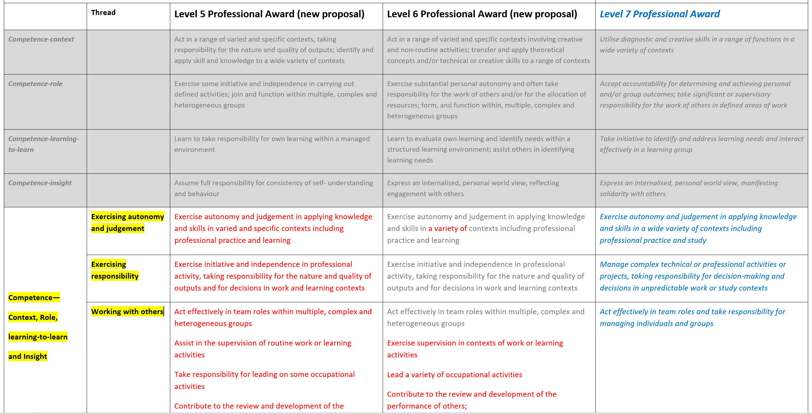
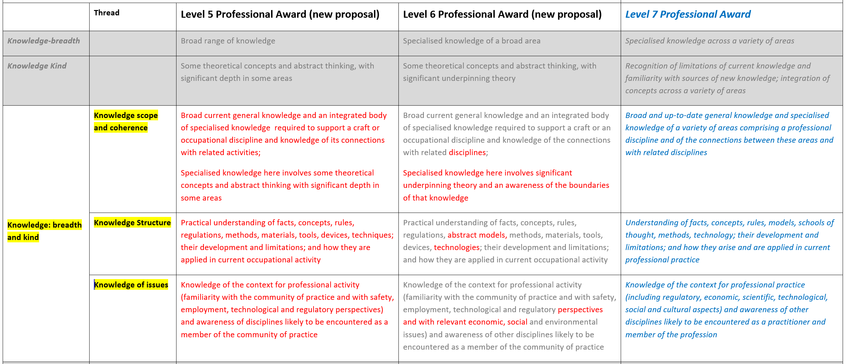
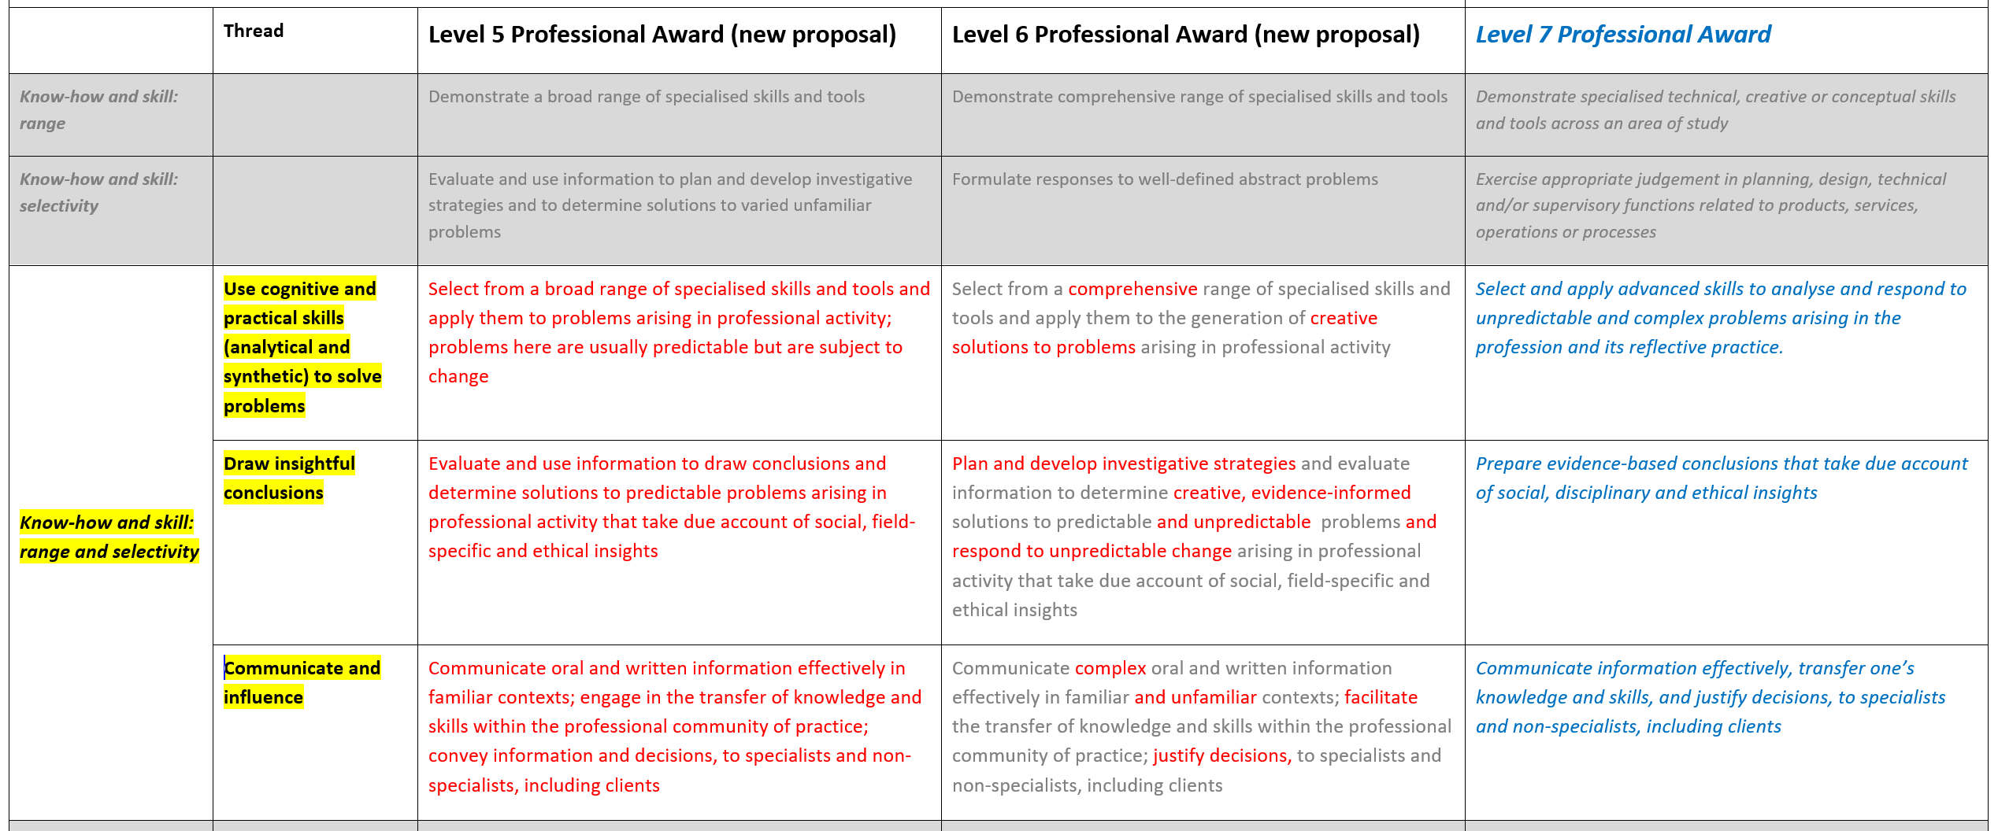
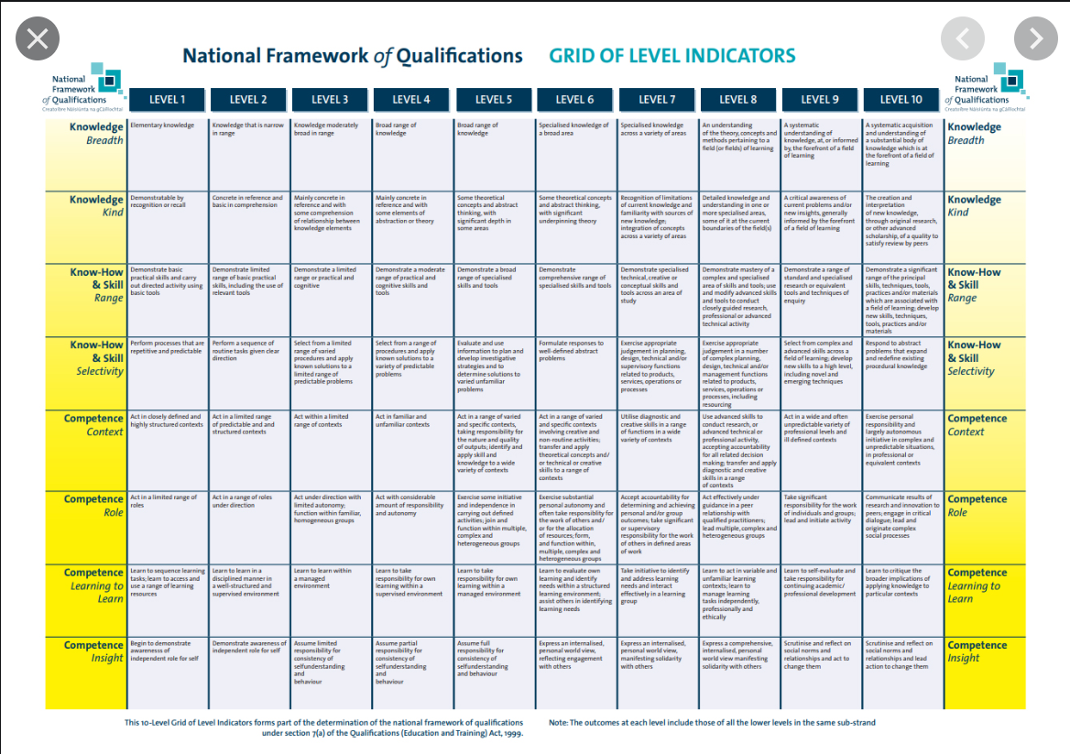
Where can I learn about standards?
Grid of Level Indicators for the National Framework of Qualifications
QQI Professional Award Type Descriptors (PATD)
Minimum Intended Learning Outcomes (programme and module) included in the validated apprenticeship programme
Occupational Profile
Notes:
When we talk about the role of the external authenticator being to provide independent confirmation of fair and consistent assessment of learners in accordance with national standards, it is helpful to know what sources of information we can use to define what is meant by national standards.
You may remember from the original two-day external authenticator training event that we looked at the grid of level indicators for the National Framework of Qualifications which was slide 16 in the original Powerpoint presentation. The grid was also provided as an insert, behind the first tab, in the folders provided on that day. The statements on the grid provide the basis for all QQI awards and provide detail on the relevant standards of knowledge, know-how and skill and competence that are specific to each level on the National Framework of Qualifications
The Professional Award-type Descriptors which we looked at earlier in this presentation, list the statements, in the greyed out boxes, exactly as they appear in the grid of level indicators. Underneath the sub-strands of knowledge, know-how and skill and competence, QQI has teased out what the sub-strands mean in the context of a professional award and professional practice and this information is provided under the listed threads in the table. The detail explaining what each thread relates to appears in red text in the table. The grey text used in the level 6 column is to indicate the text that is carried from, or is the same as, the level 5 text. The red text in the level 6 column therefore is a description of the progression in the knowledge, know-how and skill or competence from level 5. As we have previously mentioned, the level 7 information is provided for reference purposes only
We will look at the statements of minimum intended learning outcomes in more detail in a moment but suffice it to say at this stage that the statements in red from the Professional Award-type Descriptors will inform the development of these learning outcomes and all minimum intended learning outcomes will be consistent with the detail provided in the Professional Award-type Descriptors
The occupational profile is described in section 3.7.5 of QQI’s Topic Specific Statutory Quality Assurance (QA) Guidelines for Apprenticeship Programmes. It is described as being the foundation on which the apprenticeship programme is built and it describes the skills, knowledge and competences that a person should have to practice autonomously in the occupation
It is important as an external authenticator that you have a solid interpretation and knowledge of the four points on the screen as they will underpin your understanding of what is meant by national standard.

Slide 10
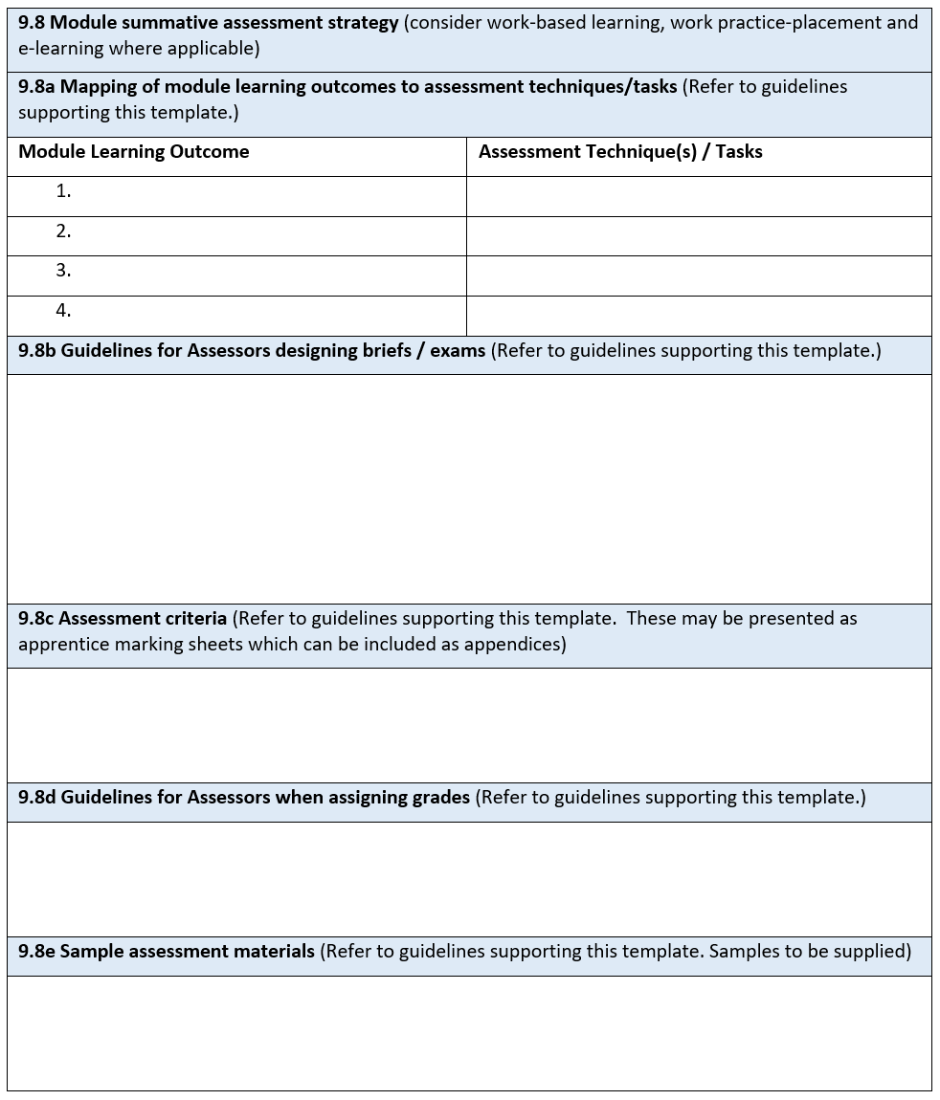
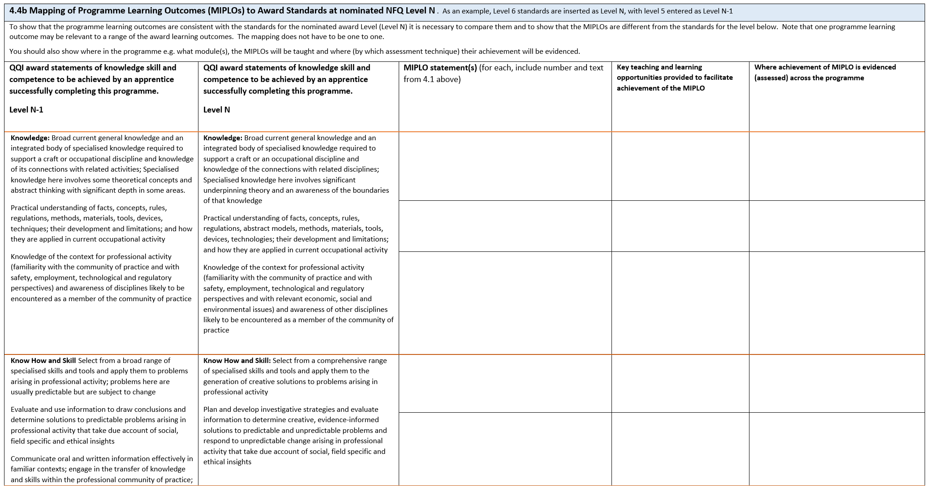
Minimum Intended Learning Outcomes
Minimum knowledge, know-how and skill and competence acquired and demonstrated by every learner in order to achieve certification
Minimum Intended Programme Learning Outcomes (MIPLOs)
Minimum Intended Module Learning Outcomes (MIMLOs)
Minimum Intended Stage Learning Outcomes (MISLOs)
All MIPLOs, MIMLOs and/or MISLOs will be mapped to at least one teaching and learning opportunity and one assessment opportunity in the programme
MIPLOs
Consistent with
MISLOs
Award Standards
Consistent with
MIMLOs
Notes:
The validated programme will describe what every learner who successfully completes the programme should be capable of. In other words, what is the essential learning that must be acquired and demonstrated by every learner, through assessment, before they can achieve certification. This essential learning is detailed in what are known as minimum intended learning outcomes.
For apprenticeship programmes leading to awards as described in the Professional Award-type Descriptors, there are three different types of minimum intended learning outcomes. All programmes will include detail relating to:
Minimum intended programme learning outcomes, or MIPLOs, which focus on the key learning in the programme as a whole
Minimum intended module learning outcomes, or MIMLOs, which focus on the key learning in each constituent part, making up the programme
It may also be the case, as we previously noted in slide 8, that a programme may be divided into stages and in this case the programme will therefore also include reference to
Minimum intended stage learning outcomes, or MISLOs
Let’s take a moment now to look at these learning outcomes from the perspective of your role as external authenticator.
You are familiar with the concept of a learner producing evidence that demonstrates achievement of the learning outcomes associated with a module. You will remember from the original two-day training that you attended that as an external authenticator you will be provided with the assessment information relating to a module or modules in terms of the detail around assessment. This will likely include being provided with the module summative assessment strategy for the module or modules you are assigned, which will include detail on the assessment techniques and weighting, a mapping of each MIMLO to an assessment technique and/or task, guidelines for the assessor, assessment criteria and so on. You will use this information to guide you as you carry out the role of external authenticator.
What may be new to you as an external authenticator, is being asked to consider the evidencing of achievement of minimum intended programme learning outcomes and/or minimum intended stage learning outcomes. All MIPLOs and/or MISLOs will be mapped to at least one teaching and learning opportunity and one assessment opportunity in a relevant module or modules. Where a provider requires you as an external authenticator to confirm evidence of achievement of MIPLOs and/or MISLOs, the provider will be able to provide information detailing where the MIPLOs and/or MISLOs are mapped to specific assessment tasks in named modules so you can review the assessment evidence produced by the learner and confirm not only the evidencing of the MIMLOs in that module, but also of the mapped MIPLOs and/or MISLOs.
Before moving on from minimum intended learning outcomes, we will remind ourselves that providers developing MIPLOs, MIMLOs and MISLOs are at all times guided by the Professional Award-type Descriptors and the occupational profile to ensure consistency between the learning outcomes and the QQI award standards.

Slide 11
Externally authenticating using MIPLOs, MIMLOs and MISLOs
The grade allocated will indicate how well the minimum intended learning outcomes were evidenced:
to a minimum acceptable standard (Pass)
to a good standard (Merit)
to an excellent standard (Distinction)
standard not evidenced (Unsuccessful)
Unsuccessful
Pass
Merit
Distinction
MIPLOs, MIMLOs and MISLOs: the minimum knowledge, know-how and skill and competence evidenced by a learner, in order to achieve certification
To be eligible for certification:
The EA must be satisfied that the learner has demonstrated achievement of the MIMLOs (and MIPLOs and MISLOs, where relevant) through the assessment evidence produced
The learner will produce evidence in line with the detail provided in the assessment strategy for the programme and the summative assessment strategies for the modules
In the context of centre-based and workplace-based assessments
Notes:
We have mentioned in the previous slides that the minimum intended learning outcomes in the form of MIPLOs, MIMLOs and where they are present, MISLOs, provide the detail around the minimum achievement that must be evidenced by a learner in order to be eligible for certification.
This concept of minimum achievement for certification is important for you to take account of in your role as external authenticator because it means that you have to be satisfied that the assessment evidence produced by the learner demonstrates the knowledge, skill and competence detailed in the minimum intended learning outcomes mapped to that assessment evidence. As we have said in the previous slide, this is not just the minimum intended module learning outcomes but may also be the minimum intended programme learning outcomes and/or the minimum intended stage learning outcomes mapped to that assessment evidence.
We know that the learner must demonstrate achievement of the minimum intended learning outcomes in order to achieve certification. The detail around how they will do this will be contained in the assessment strategies for the programme and modules.
How well the learner has evidenced this achievement then will be indicated by the grade allocated to the work. In simple terms then if the achievement of the MIMLOs (and MIPLOs and MISLOs, where relevant) is demonstrated to a minimum acceptable standard then that will result in the work being graded as a Pass, to a good standard then a Merit and to an excellent standard, a Distinction. If the learner has not demonstrated the standard at all then a grade of Unsuccessful will apply.
It will be explained in the programme how the overall grade is arrived at for the learners completing the programme. This information will be provided to you, as the external authenticator, by the provider.
QQI’s detailed grading criteria for levels 4-6 was provided at the original two-day training and you will find it as a purple coloured handout behind the first tab in the folder that was given out at that training. This is a very useful resource when reviewing the grading of learner assessment evidence and determining whether or not the grading is in line with national standards. This grading criteria is also available in Section 3.6.1 of the QQI Quality Assuring Assessment, Guidelines for Providers, Revised 2013 (Version 2 - revised 2018*) document.
Remember also that the assessment evidence produced by the learner will likely represent assessments carried out in both the workplace and the educational or training institution. This many mean that the assessment evidence takes a form that you are not as familiar with from your work with programmes leading to awards in the common awards system. The important thing is that the assessment evidence is consistent with the detail provided in the programme assessment strategy and the summative assessment strategies for the relevant module or modules.

Slide 12
Preparing for External Authentication - Apprenticeship
Confirm the availability of
all MIPLOs and MIMLOs for the programme and related modules
summative assessment strategy for the programme and related modules
learner assessment evidence
learner assessment results recorded
sampling strategy
internal verification report(s)
external authentication report template
appropriate equipment to moderate assessment evidence produced in a multi-media format, if required
Notes:
Before we finish looking at apprenticeship programmes, it is worth reminding you of the contents of slide 101 from the Powerpoint presentation used at the original two-day training event.
In order for you to complete the role of external authenticator, you will have to have access to certain information, documentation and perhaps also equipment. The provider securing your services will hopefully have these to hand anyway, but it is always a good idea to agree their availability when discussing the arrangements for your visit so that there is no time wasted in looking for them on the day.
As each apprenticeship programme is guided by the QA procedures, or QAPs, relevant to that programme, the documentation listed may take on different forms across the sector and that is fine as long as the detail that you need to be able to carry out the role of external authenticator is present for you.

Slide 13
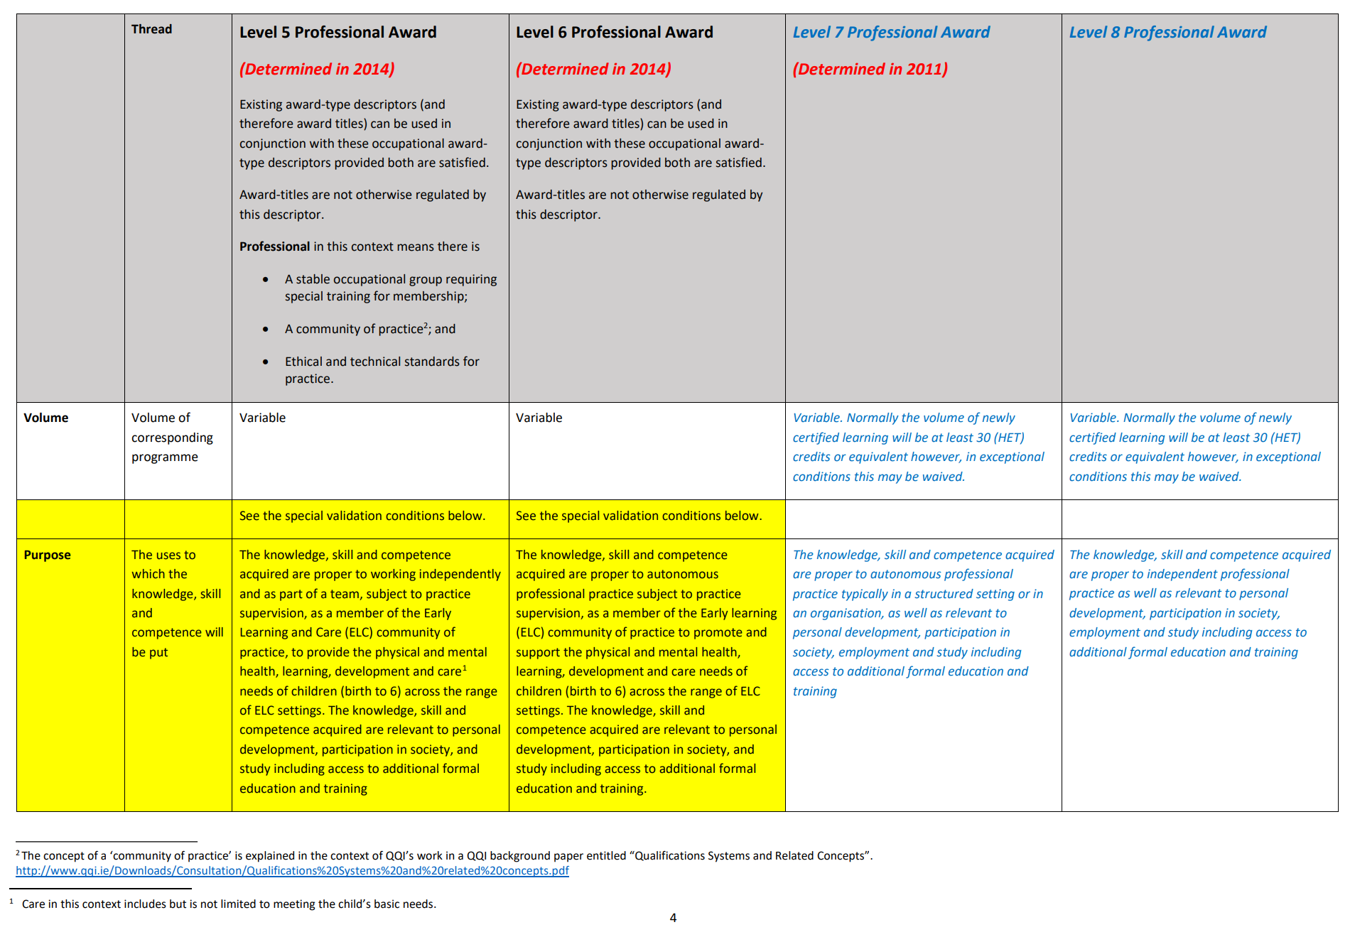
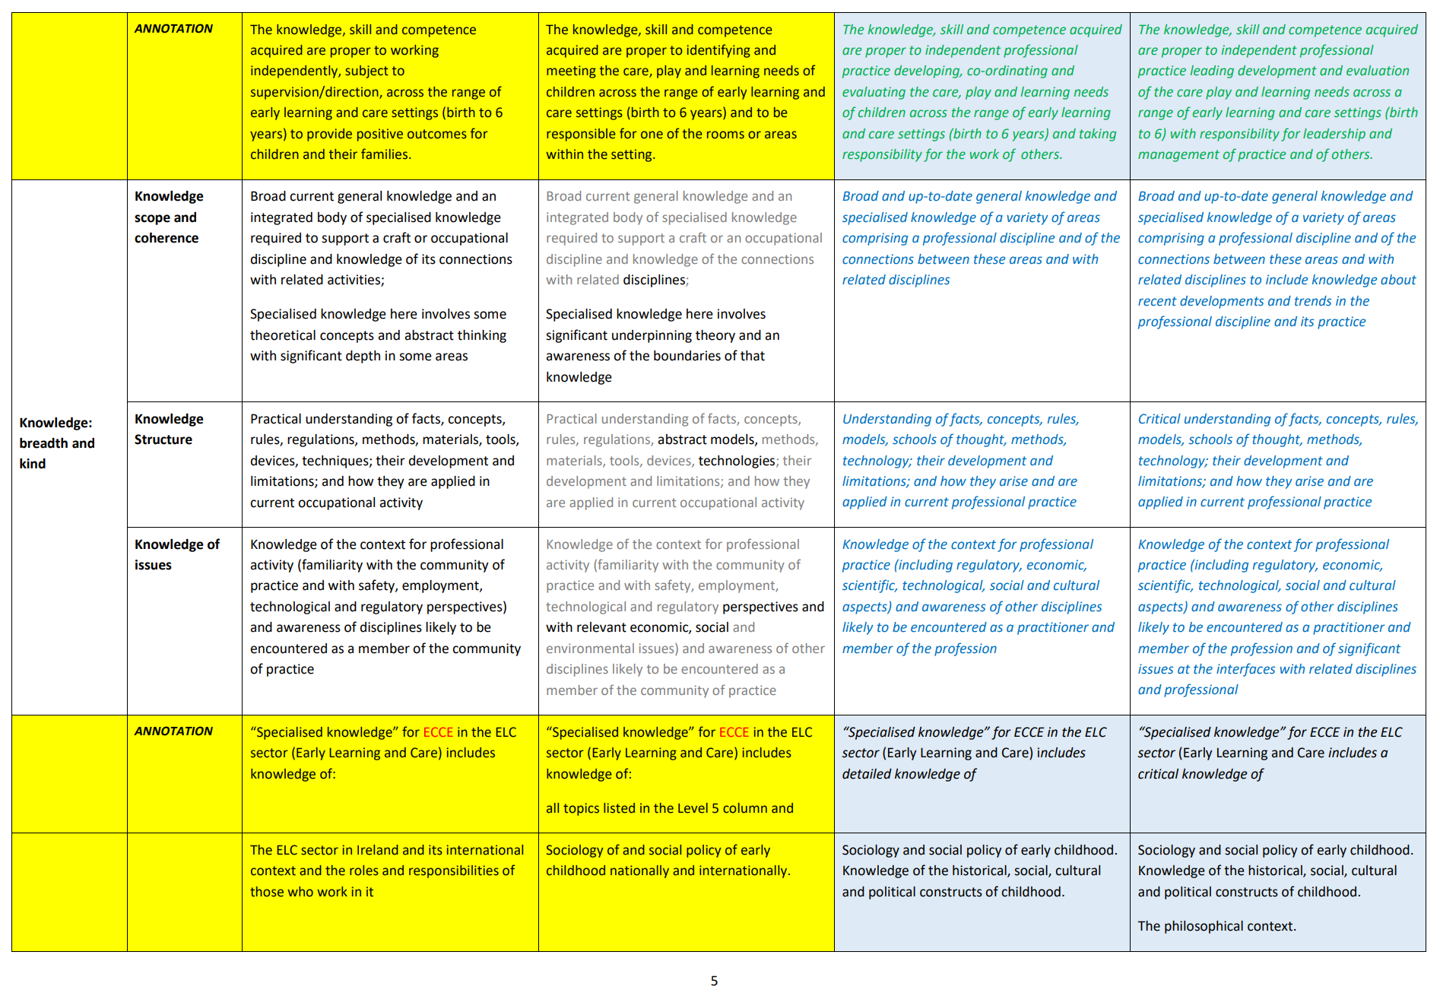
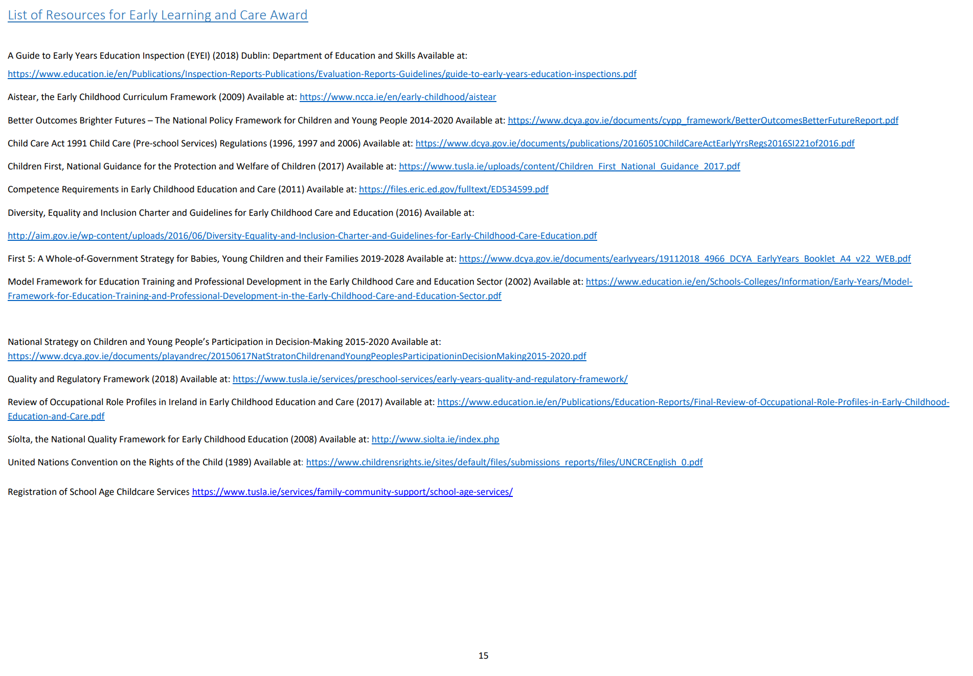
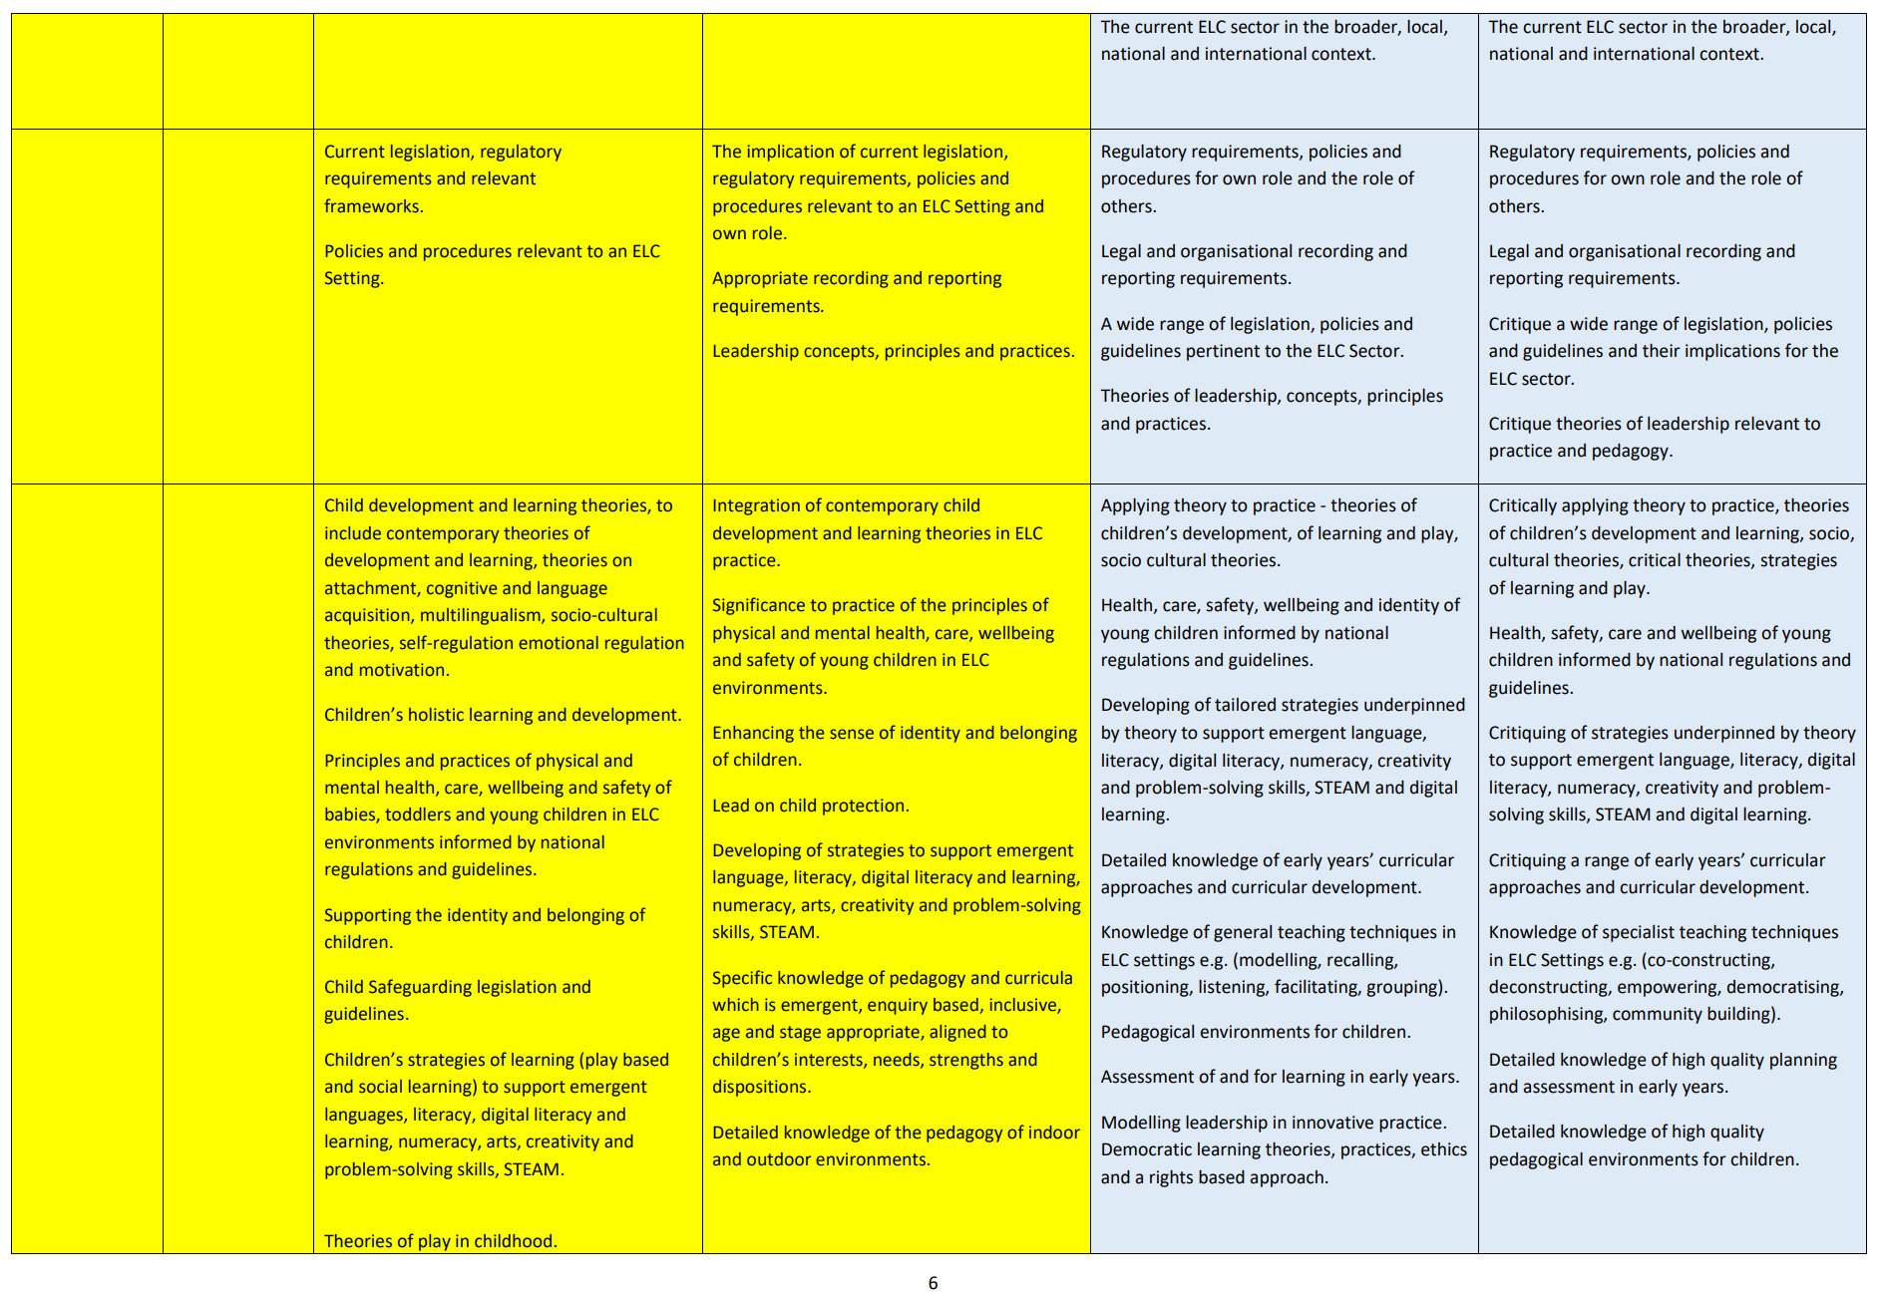
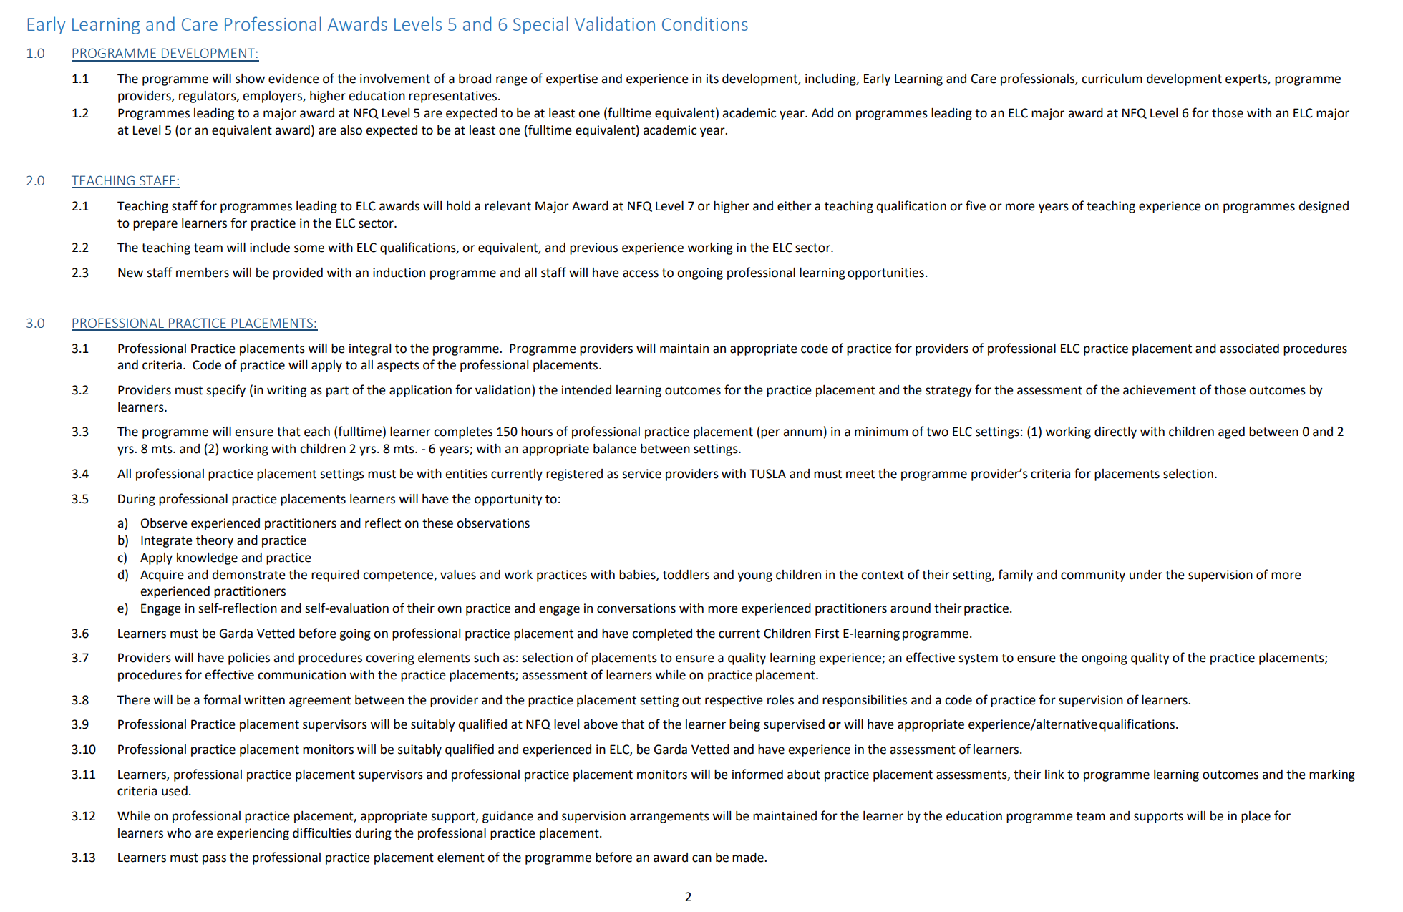
Annotated Professional Award-type Descriptors
Notes:
For the majority of this presentation, we have focused on the application of the Professional Award-type Descriptors through the development of apprenticeship programmes. It is worth noting though before we finish up that in 2019 QQI published Professional Award-type Descriptors at NFQ Levels 5 to 8 that are annotated for QQI Early Learning and Care (ELC) Awards. This document is available on the QQI website, should you wish to review the contents of it.
The annotations that are contained in the descriptors document, which are appearing in the highlighted yellow cells of the table on the screen, were designed by QQI to be a reference for those developing programmes leading to the new ELC awards. The annotations also provide a framework for the detailing of MIPLOs and MIMLOs which would be expected to be consistent with the annotations. As described earlier then, your role as an external authenticator would be to consider the assessment evidence produced by the learner to determine whether or not it demonstrates achievement of the stated MIPLOs and MIMLOs.
Programmes leading to these new ELC awards are not as yet validated by QQI for use in the FET sector but once they are, the services of external authenticators will be required. Hopefully what you have learned in this presentation will be useful to you in that role, should your expertise lie in the area of childhood learning and care.
Finally, it is worth noting that the application of the Professional Award-type Descriptors in the FET sector may extend beyond the development of apprenticeship programmes and programmes leading to the new ELC awards. The detail provided in this presentation should hopefully be transferable to these other applications when and if they arise.
Thank you for taking the time to work through the presentation.

