Slide 1
The external authentication process in programmes leading to awards as described in the National Framework of Qualifications (NFQ) Award-type Descriptors
Notes:
This presentation will focus on the external authentication process in programmes leading to awards as described in the National Framework of Qualifications (NFQ) Award-Type Descriptors.

Slide 2
This presentation
There are 9 slides
The presentation takes approximately 22 minutes
The aim of this presentation is to build on your knowledge of the external authentication process, with specific reference to working as an external authenticator in programmes leading to awards as described in the National Framework of Qualifications (NFQ) Award-type Descriptors
Notes:
This presentation will build on the knowledge gained during the original two-day training undertaken by all those listed on the EA National Directory. It would be useful to have the folder from the two-day training event to hand while working through this presentation as reference will be made to the original Powerpoint presentation and some of the other handouts in that folder. If you do not have the folder to hand, please note that all references to the contents of the folder, in this presentation, will be accompanied by a screenshot of the relevant document or slide.
The main focus of this presentation is on the National Framework of Qualifications (NFQ) Award-Type Descriptors which can be viewed in a document called Determinations for the Outline National Framework of Qualifications, which is available to download on the QQI website.

Slide 3
Some Background Information …
Notes:
At the original two day training event we discussed working as an external authenticator in the contexts of both further education and training. We explored the external authentication process for programmes leading to awards in the Common Awards System or CAS, and we also spent a little time talking about apprenticeship programmes that would have been developed in line with the Professional Award-type Descriptors.
In this presentation we want to explore the external authentication process for programmes that have been developed in line with the NFQ Award-type Descriptors, which are contained in a document called Determinations for the Outline National Framework of Qualifications.
An obvious question you may have is when would an NFQ award-type descriptor be used? It would be used by a provider who wants to offer certification in an award that does not exist but that can be proposed through the development of a programme. In other words the award and the programme are developed at the same time and the learning outcomes of the newly validated programme become the standard of the associated award. Sometimes these programmes can be referred to as programmes leading to non-CAS awards.
Before we look at the NFQ award-type descriptors in more detail we will just remind ourselves about what we learned about standards from the original two day training event.

Slide 4
Some Background Information … Standards
=
- Including MIPLOs and MIMLOs
Notes:
Using slide 12 of the original Powerpoint presentation, we considered what the role of the external authenticator entails. Amongst other things we discussed the importance of the external authenticator being able to provide independent confirmation of fair and consistent assessment of learners in accordance with national standards.
We took some time to tease out what we mean by national standards, over a number of slides. Specifically, we focused on the National Framework of Qualifications, the Grid of Level Indicators, the standards as indicated in the QQI award specifications, the provider’s validated programme and the QQI Grading Criteria.
For the purposes of looking at the external authentication process for programmes leading to awards as described in the NFQ Award-Type Descriptors, when we talk about “standards as indicated in the award specification”, we are talking about standards as described in the relevant award-type descriptor and when we talk about validated programme, we are including reference to minimum intended programme learning outcomes or MIPLOs and minimum intended module learning outcomes or MIMLOs.

Slide 5
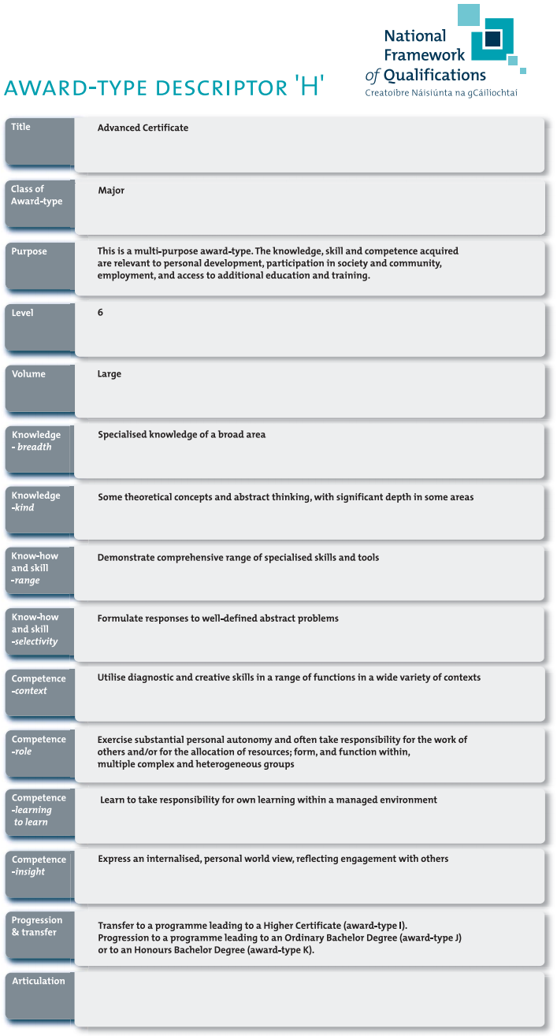
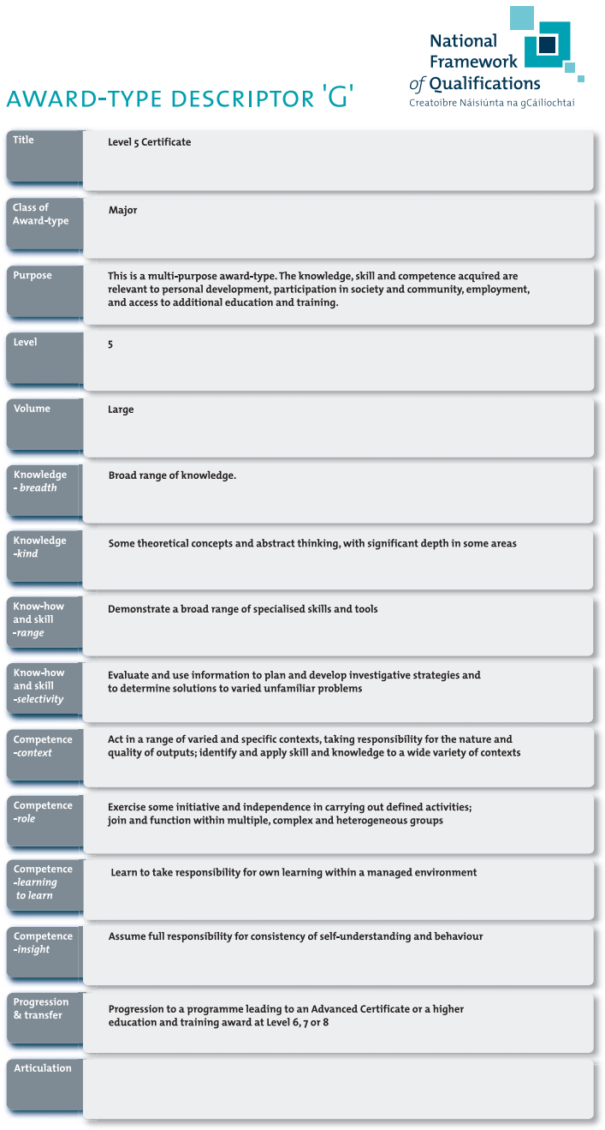
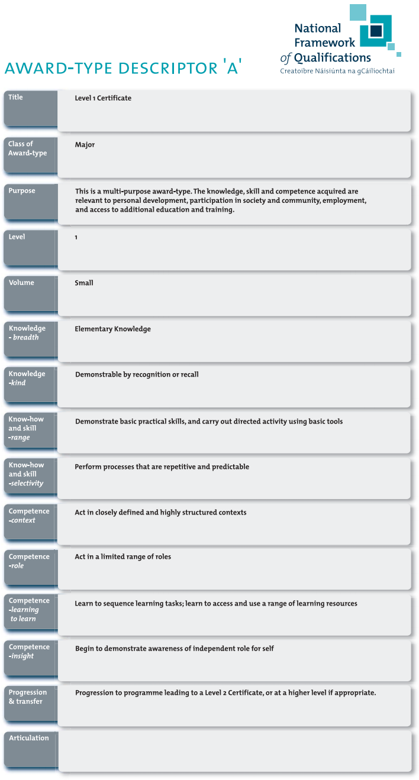
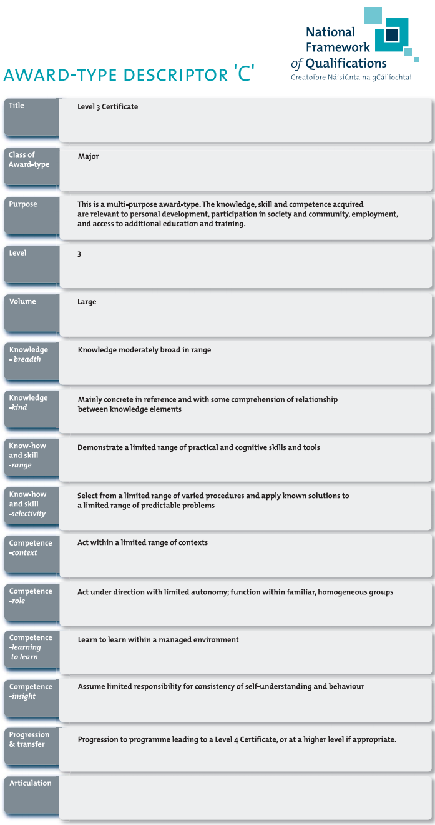
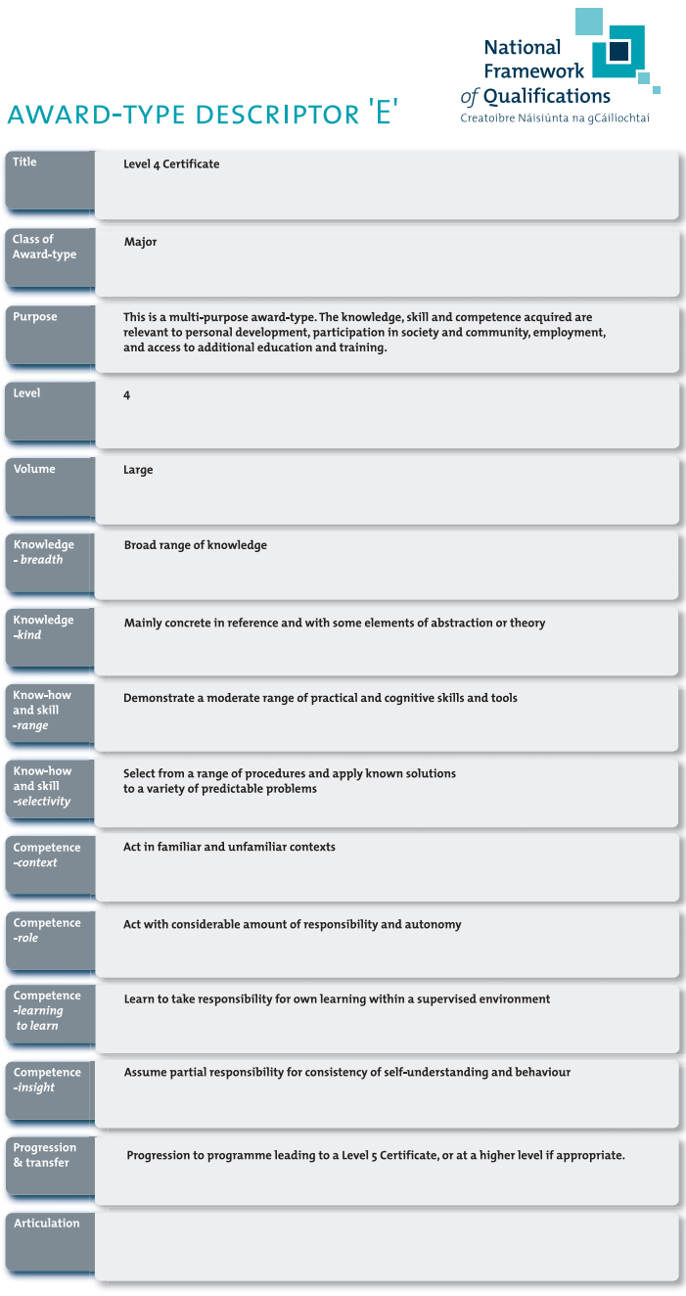
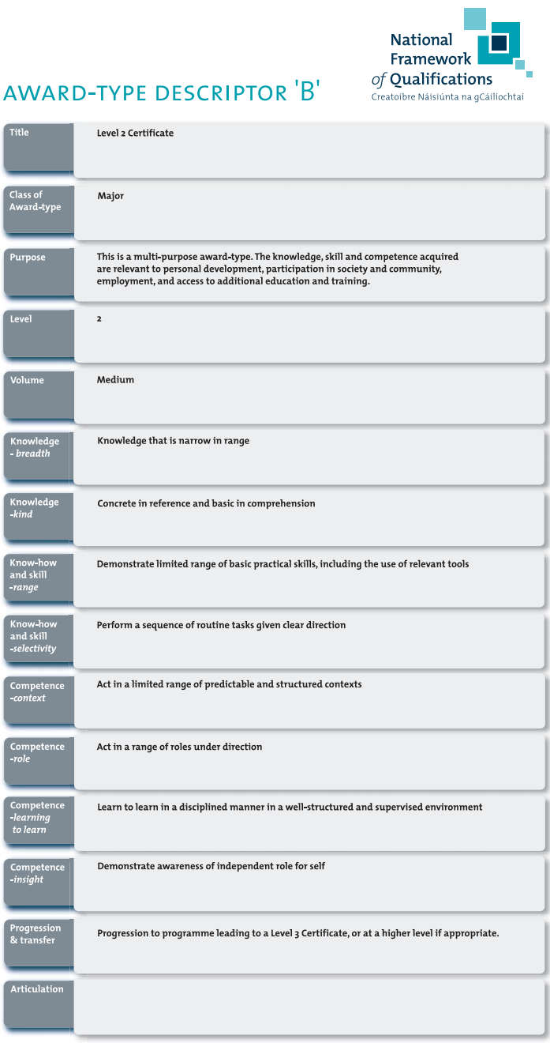
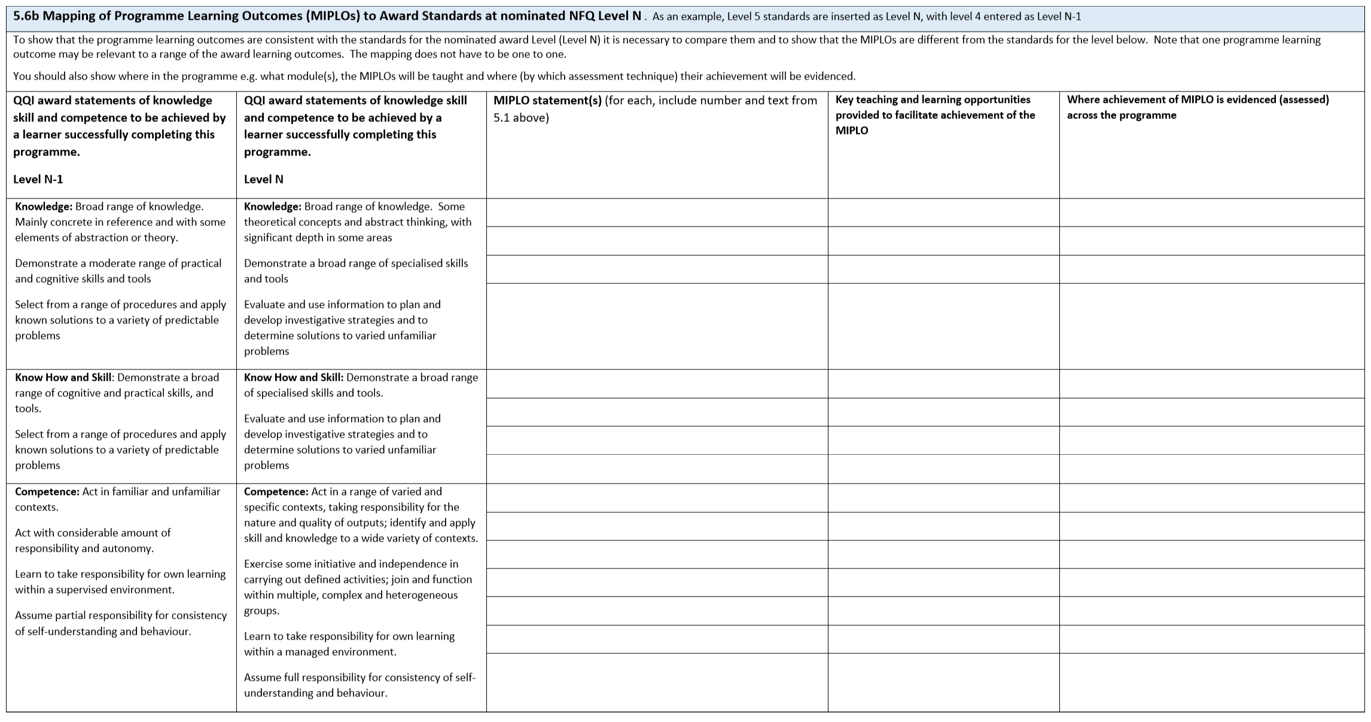
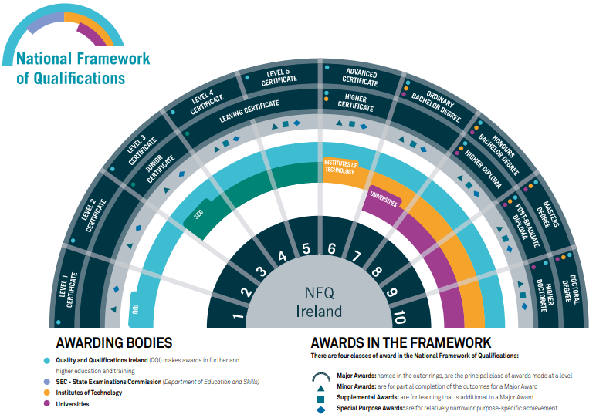
Award-type Descriptors
Notes:
In total there are fifteen award-type descriptors for the NFQ, from Award-type Descriptor ‘A’ which describes the detail associated with a Level 1 Certificate, up to Award-type Descriptor ‘O’ which describes the detail associated with a Level 10 Doctoral Degree.
For the purposes of the EA national directory, we are interested in the awards made by QQI from NFQ levels 1 to 6 because it is in this space that the FET sector operates, therefore, it is the Award-type Descriptors ’A’ (Level 1 Certificate), ‘B’ (Level 2 Certificate), ‘C’ (Level 3 Certificate), ‘E’ (Level 4 Certificate) , ‘G’ (Level 5 Certificate) and ‘H’ (Level 6 Advanced Certificate), that we have particular interest in. For your information Award-type Descriptors ‘D’ and ‘F’ describe the detail for the Junior Certificate and Leaving Certificate, respectively.
Each award-type descriptor contains information relating to the major award. However, the statements of knowledge, know-how and skill and competence contained in the descriptor will also be relevant to the other award types at that level, be they minor, special purpose and/or supplemental.
It is these statements of knowledge, know-how and skill and competence, that communicate the high-level learning that a successful learner will acquire, and where appropriate demonstrate, in order to achieve certification at that level. That is why it is important that you, as an external authenticator, are familiar with them and understand the standard being communicated in the statements.
You may notice that, in the main, the statements of knowledge, know-how and skill and competence in the award-type descriptors are the exact same as the statements from the Grid of Level Indicators which we looked at in slide 16 in the original Powerpoint presentation and which was also included in the folders provided on that day.
Where there may be a slight difference in the statements is where there is more than one award being made at an NFQ level. For example, the statements of knowledge, know-how and skill for the NFQ Level 6 Advanced Certificate are slightly different to those for the NFQ Level 6 Higher Certificate and therefore not the exact same as the statements as they appear in the grid.
As an external authenticator, it is important that you understand the relevant award-type descriptor, as the statements of knowledge, know-how and skill and competence in the descriptors form the basis for the development of programmes leading to these awards, and the development of the minimum intended learning outcomes in the form of MIPLOs and MIMLOs within those programmes, which we will look at in a moment.

Slide 6
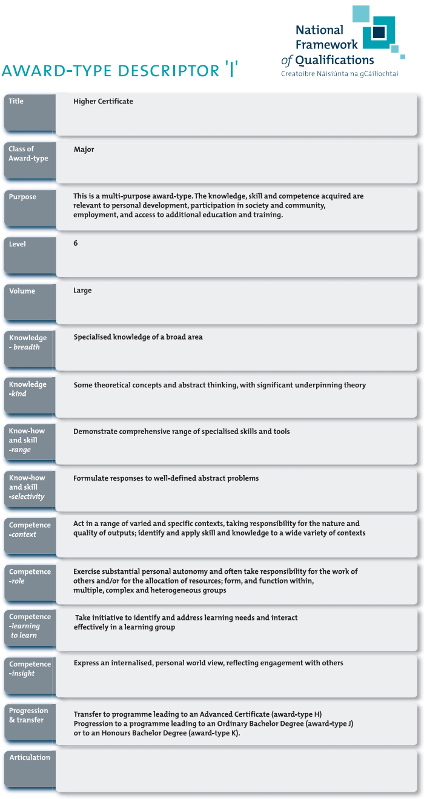
NFQ Level 6 Higher Certificate
6
Notes:
We mentioned in the previous slide that for the purposes of the EA national directory, we are interested in the awards made by QQI from NFQ levels 1 to 6 because it is in this space that the FET sector operates. The vast majority of QQI certification in major awards, that the FET sector offer learners, is in QQI Certificates from NFQ Levels 1 to 5 and in the QQI Advanced Certificate at NFQ Level 6.
However, we did mention in the previous slide that currently at NFQ Level 6, QQI makes awards for both Advanced Certificates and Higher Certificates. In the case where a FET provider wants to offer certification in an NFQ Level 6 Higher Certificate, that provider may propose a new award through the development of a programme, as long as the new programme is developed in line with the award-type descriptor ‘I’ which describes the information relevant to the Higher Certificate and as long as the provider has all necessary quality assurance processes and appropriate scope of provision permissions in place.
At the time of publication of this presentation there is one instance of an ETB developing a programme leading to a Higher Certificate, where that programme has been validated by QQI. This is not to say that this will be the only instance of programme development at NFQ Level 6, leading to a Higher Certificate.
Really the important thing to note is that by allowing providers to develop programmes where the learning outcomes of the newly validated programme become the standard of the associated award, allows for a lot of flexibility in the sector. The use of award-type descriptors, as the basis on which to develop FET programmes, may become more common, as a result.
Now that we have looked at the standards as indicated in the award-type descriptors, we will move our focus to the validated programme.

Slide 7
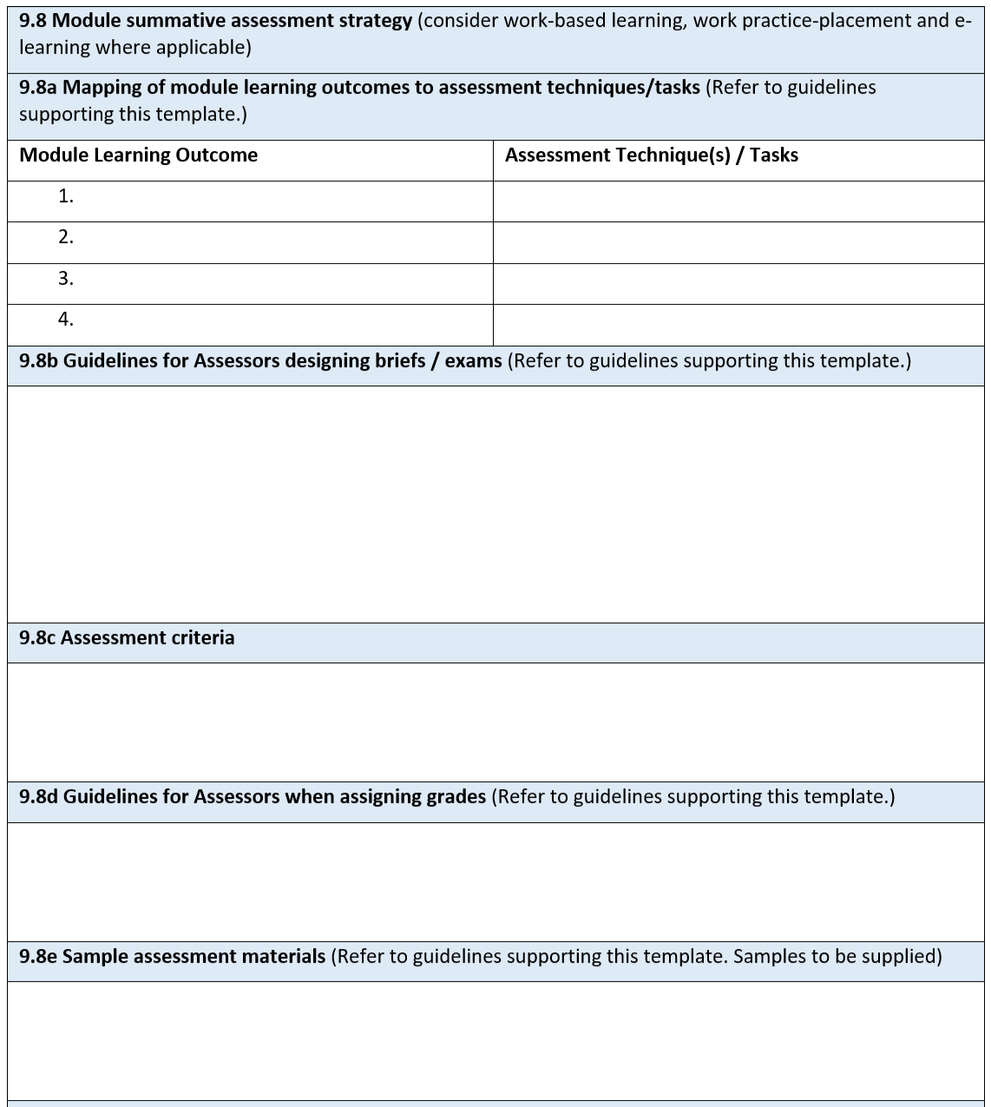
Minimum Intended Learning Outcomes
Minimum knowledge, know-how and skill and competence acquired and demonstrated by every learner in order to achieve certification
Minimum Intended Programme Learning Outcomes (MIPLOs)
Minimum Intended Module Learning Outcomes (MIMLOs)
All MIPLOs (and MIMLOs) will be mapped to at least one teaching and learning opportunity and one assessment opportunity in the programme
MIPLOs
Consistent with
Award Standards
Consistent with
MIMLOs
Notes:
The validated programme will describe what every learner who successfully completes the programme should be capable of. In other words, what is the essential learning that must be acquired and demonstrated by every learner, through assessment, before they can achieve certification. This essential learning is detailed in what are known as minimum intended learning outcomes.
All programmes will include detail relating to:
Minimum intended programme learning outcomes, or MIPLOs, which focus on the key learning in the programme as a whole
Minimum intended module learning outcomes, or MIMLOs, which focus on the key learning in each constituent part, making up the programme
Let’s take a moment now to look at these learning outcomes from the perspective of your role as external authenticator.
You are familiar with the concept of a learner producing evidence that demonstrates achievement of the learning outcomes associated with a module. You will remember from the original two-day training that you attended that as an external authenticator you will be provided with the assessment information relating to a module or modules in terms of the detail around assessment. This will likely include being provided with the module summative assessment strategy for the module or modules you are assigned, which will include detail on the mapping of each MIMLO to an assessment technique and/or task, guidelines for the assessor, assessment criteria, guidelines for assigning grades and so on. You will use this information to guide you as you carry out the role of external authenticator.
What may be new to you as an external authenticator, is being asked to consider the evidencing of achievement of minimum intended programme learning outcomes. All MIPLOs will be mapped to at least one teaching and learning opportunity and one assessment opportunity in a relevant module or modules. The expectation of QQI is that all MIPLOs will be addressed through the totality of MIMLOs across all the modules making up the programme.
Where a provider requires you, as an external authenticator, to confirm evidence of achievement of MIPLOs, the provider will be able to provide information detailing where the MIPLOs are mapped to specific assessment tasks in named modules so you can review the assessment evidence produced by the learner and confirm not only the evidencing of the MIMLOs in that module, but also of the mapped MIPLOs.
Before moving on from minimum intended learning outcomes, we will remind ourselves that providers developing programmes will ensure consistency between the minimum intended learning outcomes, the MIPLOs and the MIMLOs, and the award standards, as described in the relevant award-type descriptor.

Slide 8
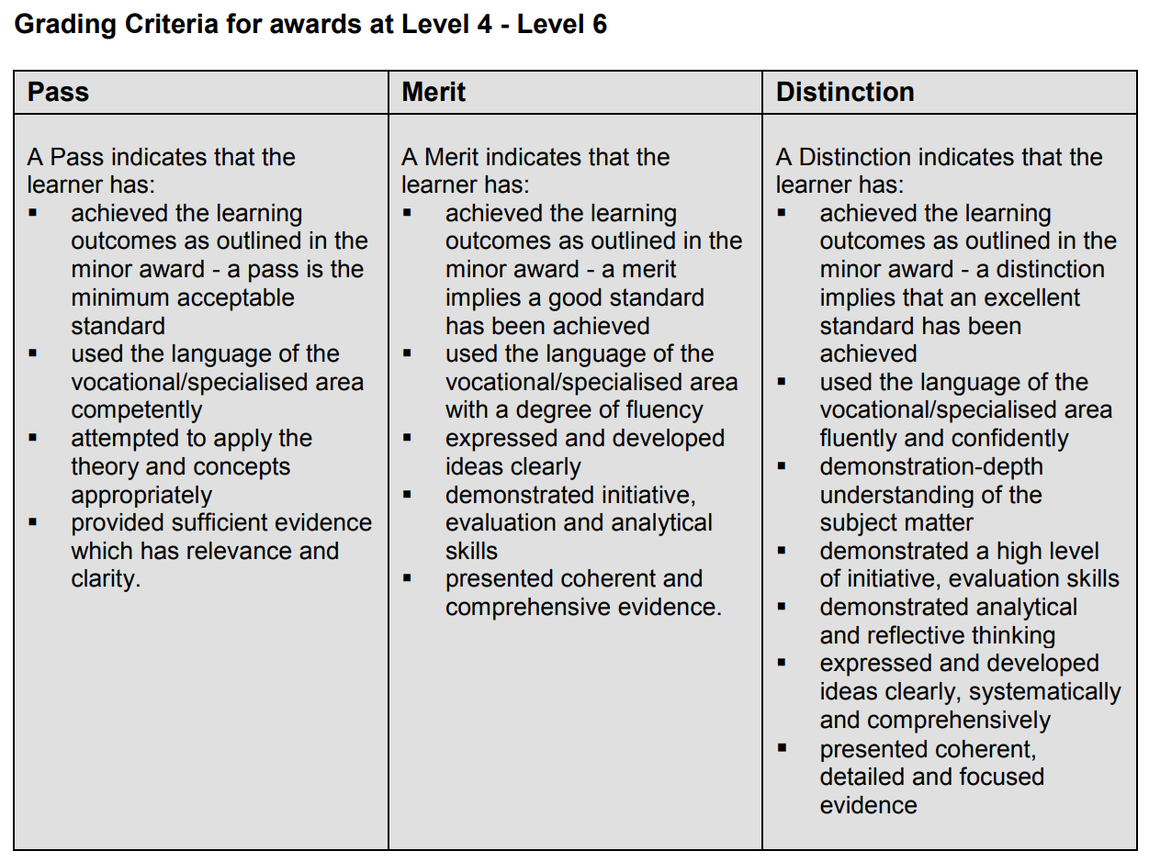
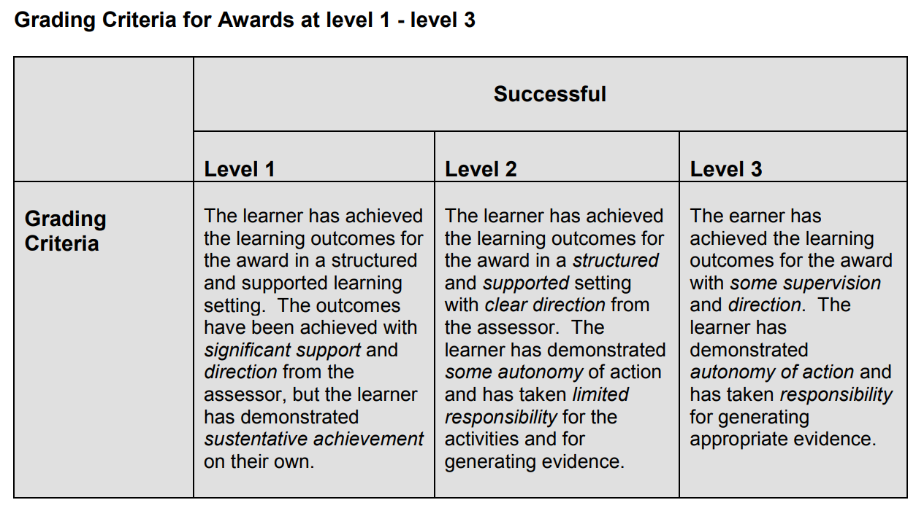
Externally authenticating using MIPLOs and MIMLOs
Unsuccessful
Pass
Merit
Distinction
Merit Merit 1 2
MIPLOs and MIMLOs: the minimum knowledge, know-how and skill and competence evidenced by a learner, in order to achieve certification
The grade allocated will indicate how well the minimum intended learning outcomes were evidenced:
to a minimum acceptable standard (Pass)
to a good standard (Merit)
to an excellent standard (Distinction)
standard not evidenced (Unsuccessful)
NFQ Levels 1 – 3
learner has achieved all the outcomes for the award (Successful)
To be eligible for certification:
The EA must be satisfied that the learner has demonstrated achievement of the MIMLOs (and MIPLOs, where relevant) through the assessment evidence produced
The learner will produce evidence in line with the detail provided in the assessment strategy for the programme and the summative assessment strategies for the modules
Notes:
We have mentioned in the previous slides that the minimum intended learning outcomes in the form of MIPLOs and MIMLOs provide the detail around the minimum achievement that must be evidenced by a learner in order to be eligible for certification.
This concept of minimum achievement for certification is important for you to take account of in your role as external authenticator because it means that you have to be satisfied that the assessment evidence produced by the learner demonstrates the knowledge, skill and competence detailed in the minimum intended learning outcomes mapped to that assessment evidence. As we have said in the previous slide, this is not just for the minimum intended module learning outcomes but may also be the minimum intended programme learning outcomes mapped to that assessment evidence.
We know that the learner must demonstrate achievement of the minimum intended learning outcomes in order to achieve certification. The detail around how they will do this will be contained in the assessment strategies for the programme and modules.
How well the learner has evidenced this achievement then will be indicated by the grade allocated to the work. For learners following programmes leading to awards at NFQ levels 4-6, in simple terms if the achievement of the MIMLOs (and MIPLOs, where relevant) is demonstrated to a minimum acceptable standard then that will result in the work being graded as a Pass, to a good standard then a Merit and to an excellent standard, a Distinction. If the learner has not demonstrated the standard at all then a grade of Unsuccessful will apply.
At the time of publication of this presentation there are no programmes leading to awards as described in the award-type descriptors at NFQ levels 1 to 3. Traditionally though it is the case that awards at NFQ levels 1-3 are classified as Successful where a learner has achieved all the outcomes for the award.
Just to note at this point also, that grading for an NFQ Level 6 Higher Certificate allows for 2 types of Merit: Merit 1 and Merit 2.
It will be explained in the programme how the overall grade is arrived at for the learners completing the programme. Assessors will also have been provided with information on how to discriminate for grading purposes. As an external authenticator, you should not assume that grading of learners following programmes leading to awards described in the NFQ Award-type Descriptors will be the same as learners following programmes leading to CAS awards. Information relating to grading should be supplied to you, by the provider.
However, before we leave this part of the presentation, we will just draw your attention to the original list that we looked at earlier indicating where we can learn about national standards. The last item on the list is QQI Grading Criteria which you may remember from the original two day training event and which can be accessed in Section 3.6.1 of the QQI Quality Assuring Assessment, Guidelines for Providers, Revised 2013 (Version 2 - revised 2018*) document. These grading criteria may be used alongside the grading information supplied by the provider and may be a useful resource when reviewing the grading of learner assessment evidence and determining whether or not it is in line with national standards.

Slide 9
Preparing for External Authentication
Agree terms and conditions for the authentication process with provider/centre:
Dates/times/venues
Volume of work – module(s) (names and levels) and numbers of learner assessment evidence/portfolio to be authenticated by each authenticator
Paperwork to be completed and the time allocated to do this
Agree the date by which the External Authentication Report will be completed
Other responsibilities – e.g. providing feedback to appropriate personnel and availability to the Results Approval Panel
Remuneration
Confirm the availability of
all MIPLOs and MIMLOs for the programme and related modules
summative assessment strategy for the programme and related modules
learner assessment evidence
learner assessment results recorded
sampling strategy
internal verification report(s)
external authentication report template
appropriate equipment to moderate assessment evidence produced in a multi-media format, if required
Other responsibilities – e.g. providing feedback to appropriate personnel and availability to the Results Approval Panel
Agree the assessment instruments and related documentation prior to programme rollout
Input to the review of the programme
Other
Remuneration
Notes:
There were a couple of times during the original two-day training event where we gave some time to looking at preparing for external authentication. It is worth remembering that in order for you to complete the role of external authenticator, you will have to have access to certain information, documentation and perhaps also equipment. The provider securing your services will hopefully have these to hand anyway, but it is always a good idea to agree their availability when discussing the arrangements for your visit so that there is no time wasted in looking for them on the day.
It is also worth reminding you that all programmes offered by the provider are guided by the provider’s relevant quality assurance processes, and relevant documentation. For this reason the documentation listed may take on different forms across the sector and that is fine as long as the detail that you need to be able to carry out the role of external authenticator is present for you.
We mentioned at the original two day training event the importance of agreeing terms and conditions with the provider and clarifying the detail around these.
When it comes to agreeing other responsibilities with the provider or centre, we had mentioned originally that this could involve providing feedback to appropriate personnel and perhaps being available to the results approval panel.
It is worth pointing out that developing programmes that lead to awards as described in the NFQ Award-type Descriptors is a very new activity for the FET sector so providers could also wish to use the services of an external authenticator to work with the provider prior to the rollout of the programme to agree the assessment instruments in the form of assessment briefs and/or examination papers and their related documentation such as marking schemes and outline solutions or have an input when the programme is being reviewed, for example.

Slide 10
Summary
Notes:
We mentioned in the original two-day training event that it is important to remember that all ETBs are quality assured providers and therefore there will be QA processes underpinning all their FET activity, including for the programmes leading to awards as described in the NFQ Award-type Descriptors.
Across FET provision, the ETBs now offer programmes leading to CAS awards, apprenticeship programmes and the new programmes leading to awards as described in the NFQ Award-type Descriptors, as described in this presentation. This means that there is huge diversity across providers and therefore many opportunities for external authenticators.

